Slide 1
White-Rodgers
Heating Controls

Slide 2
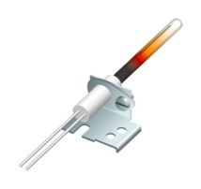
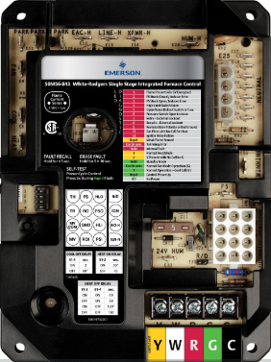
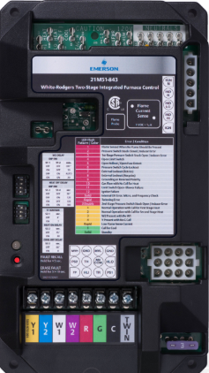
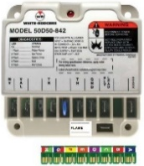
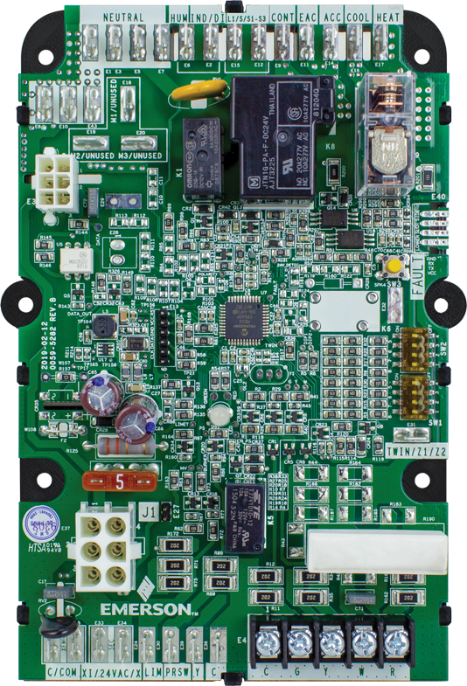
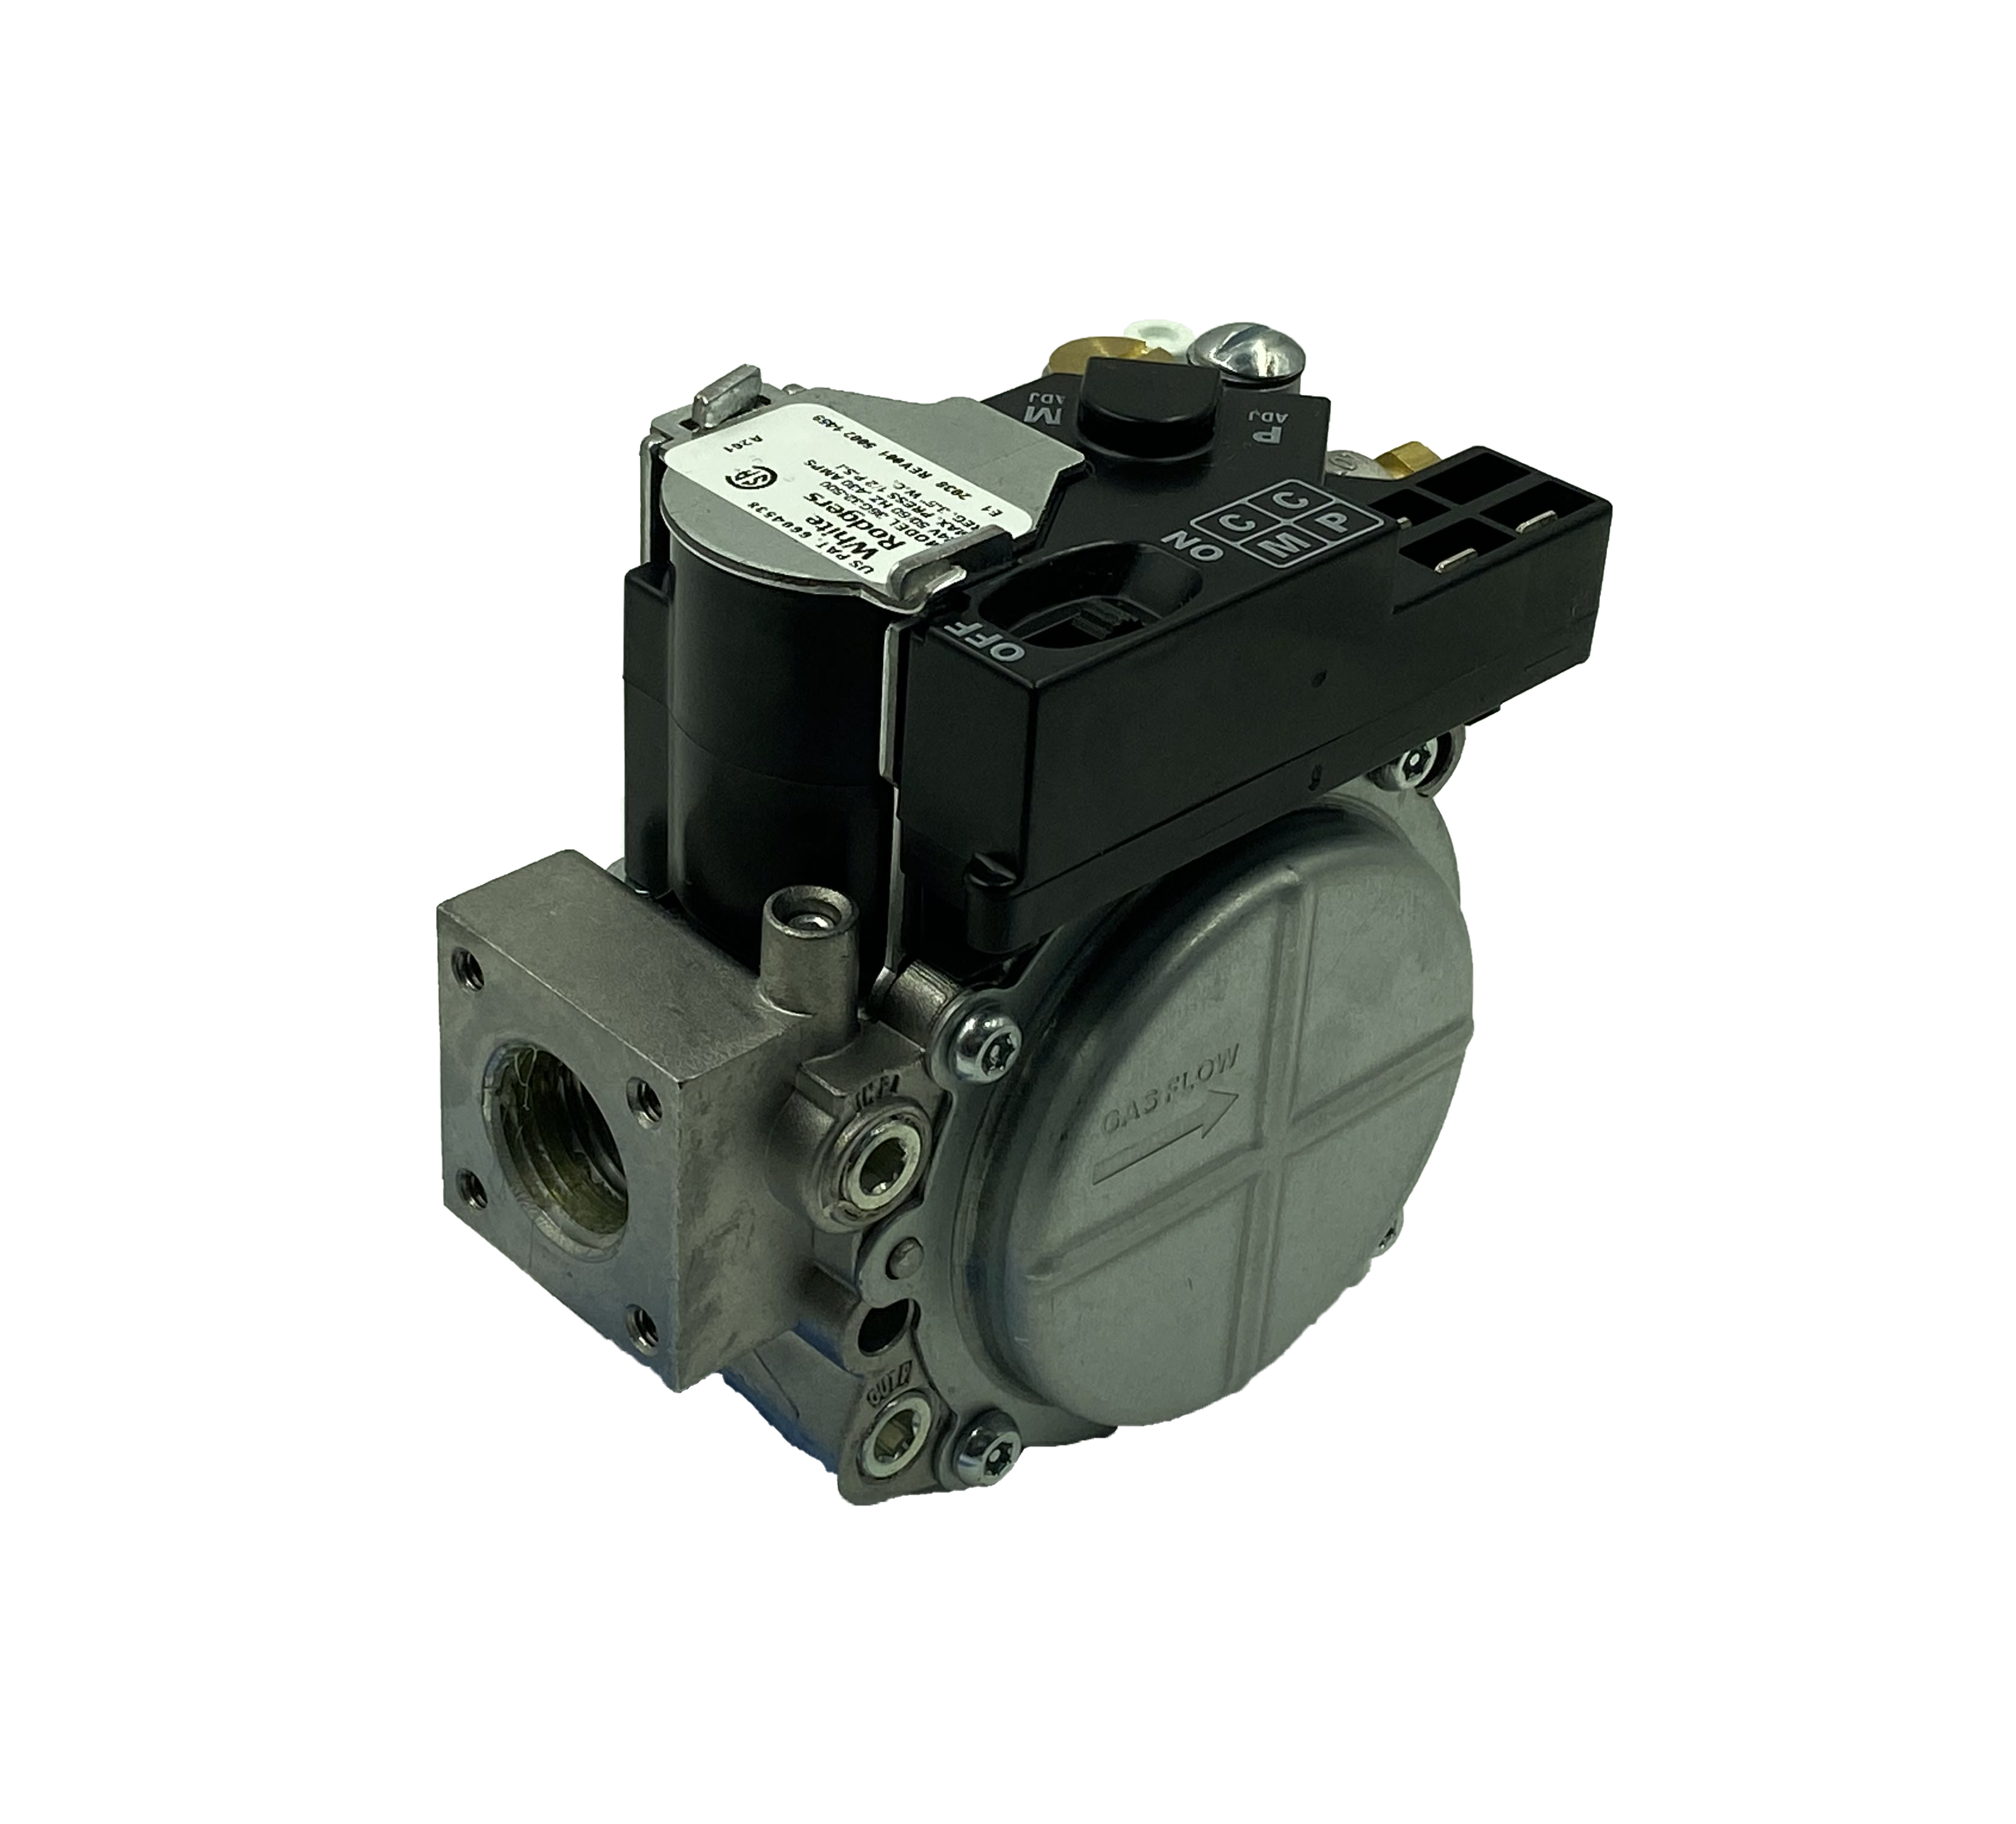
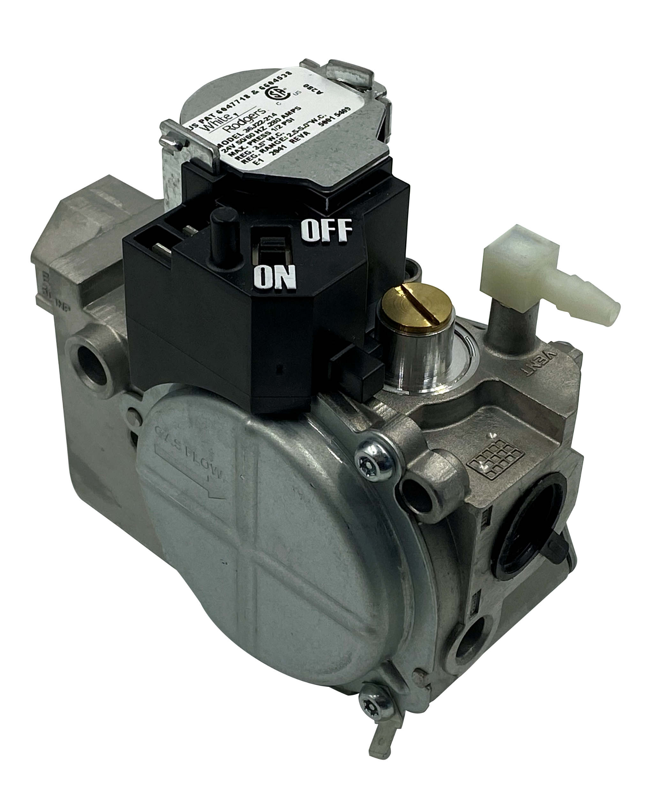
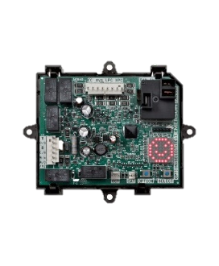
White-Rodgers Heating Controls
Product Group | Descriptor
Ignition Controls and Modules | Integrated Furnace Controls
 | Integrated Commercial RTU & Package Unit Ignition Controls
 | Non-Integrated Ignition Modules
 | Non-Integrated Commercial RTU & Package Unit Ignition Controls
Gas Valves | 36C Series
 | 36G/J Series
 | 36H Series
 | Gas Pilot Safety, Fireplace Valves
Hot Surface Ignitors | Universal Nitride Upgrade Ignitor Kits
 | 120v Hot Surface Ignitors
 | 80v Hot Surface Ignitors
Flame Sensors | Universal Flame Sensors
 | Direct Replacement Flame Sensors
Fan and Limit Controls | Electronic Fan Timer
 | Plenum Mount Fan and Limit Controls
 | Fan Coil

Slide 3
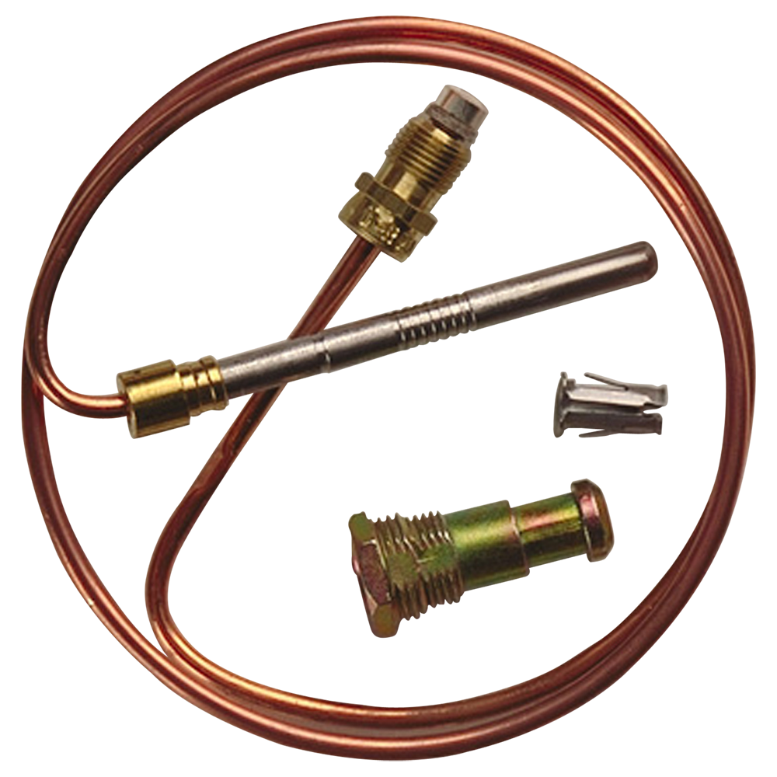
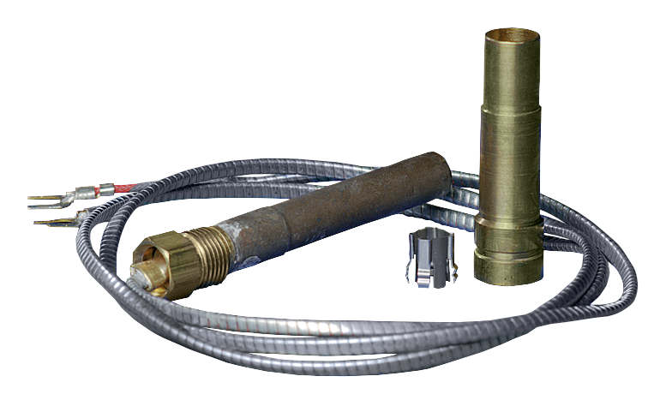
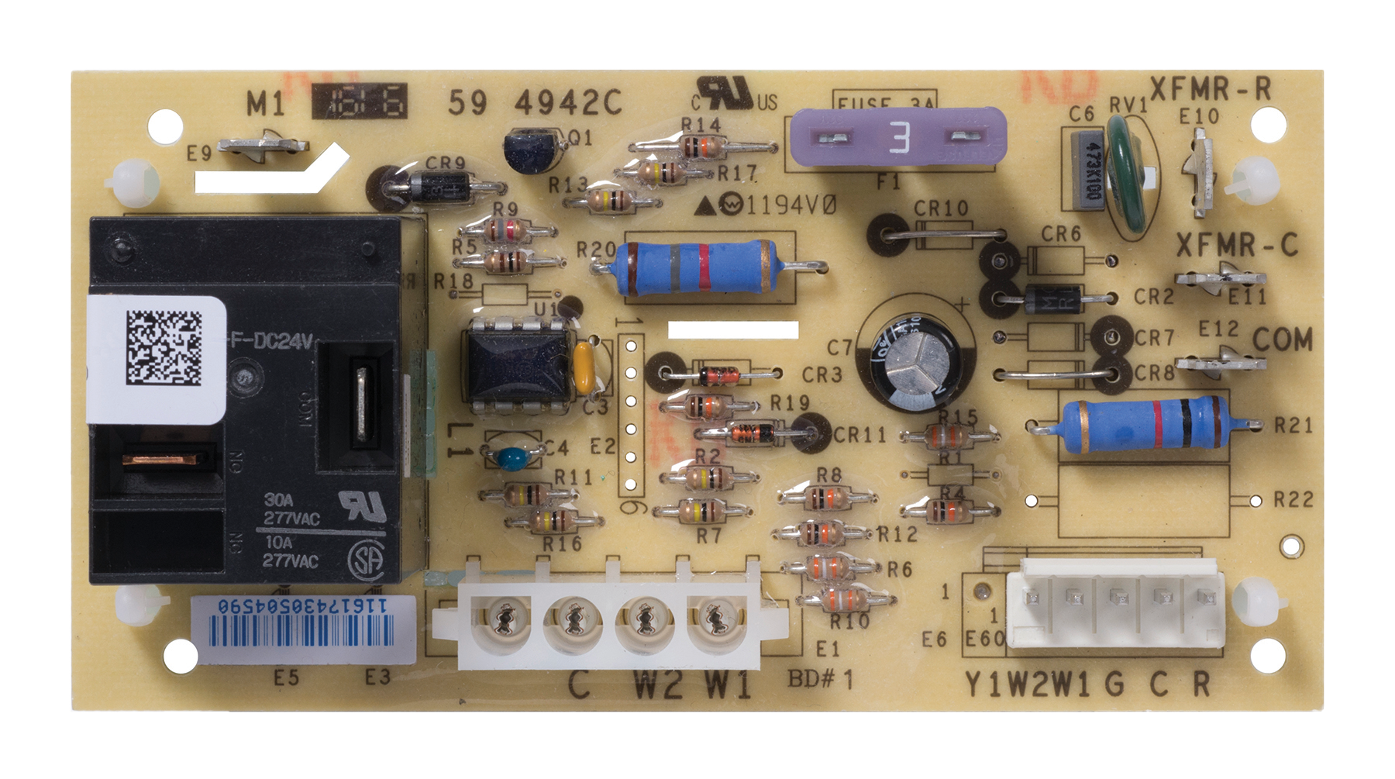
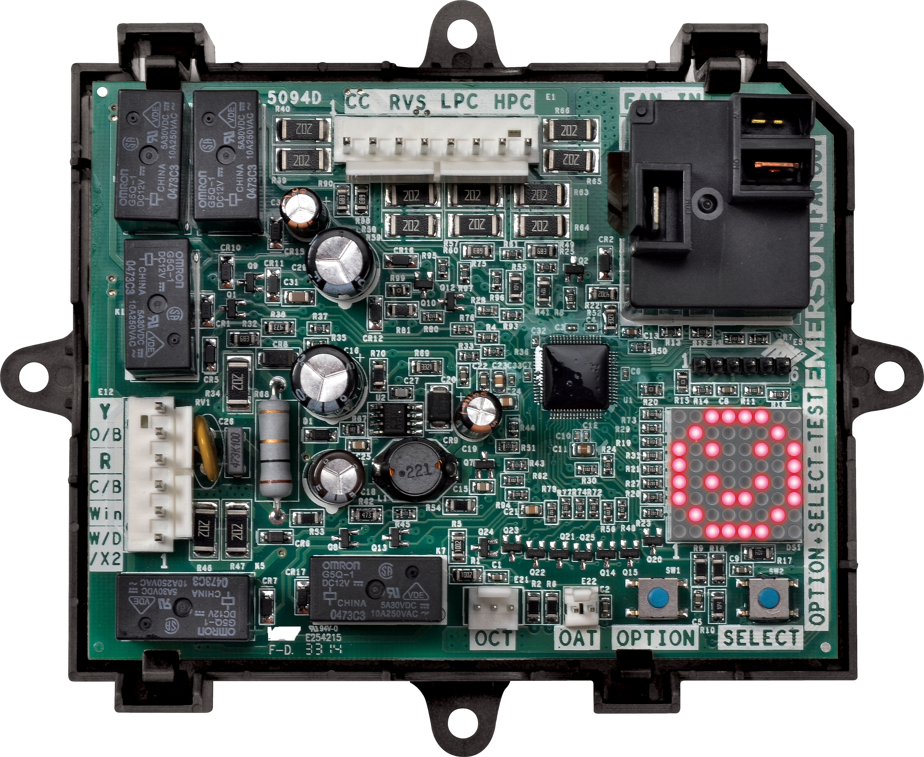
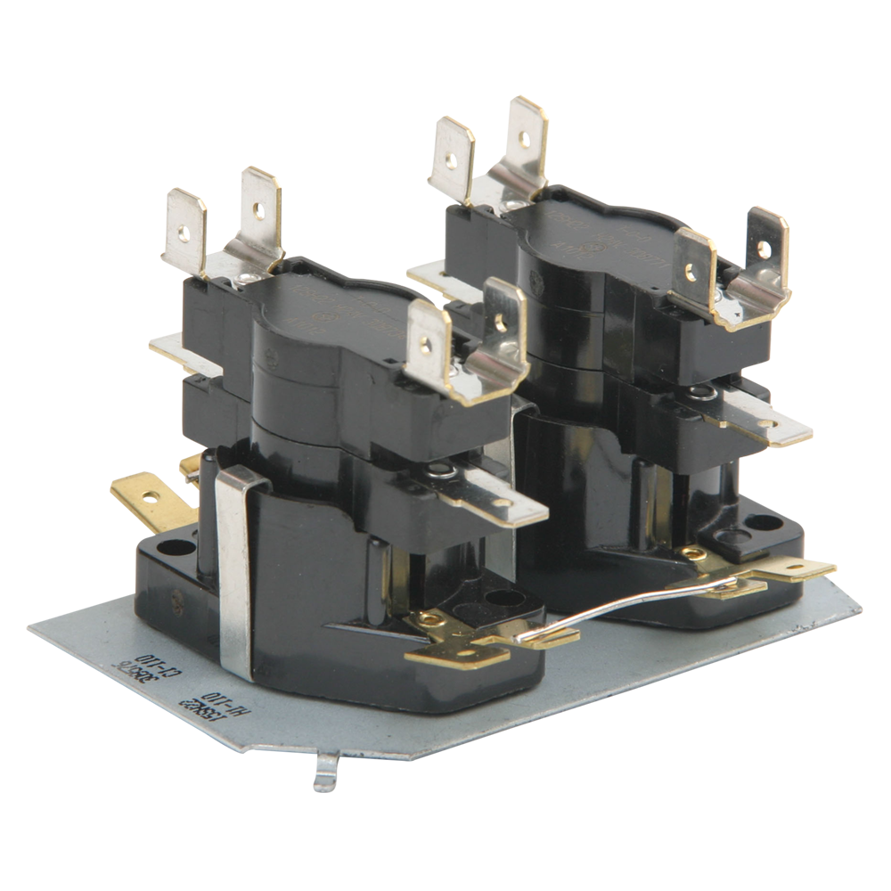
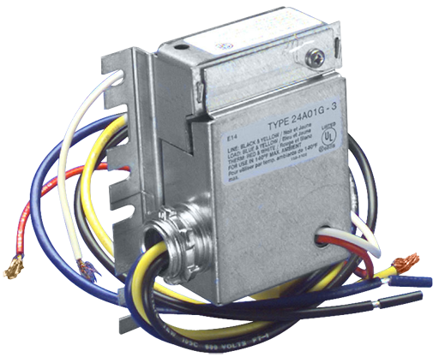
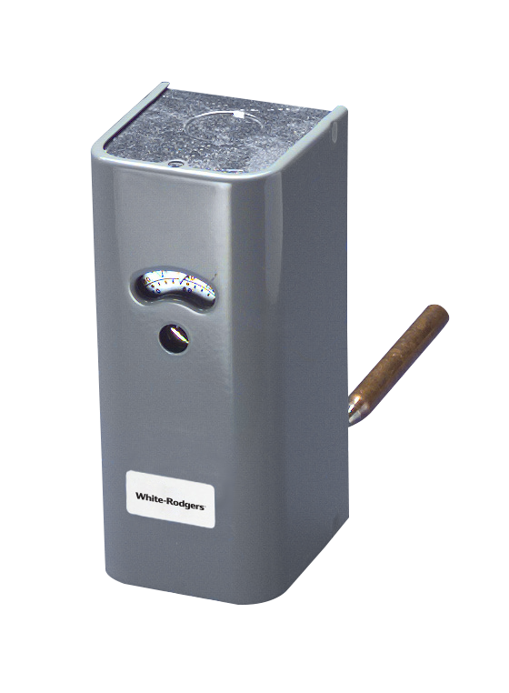
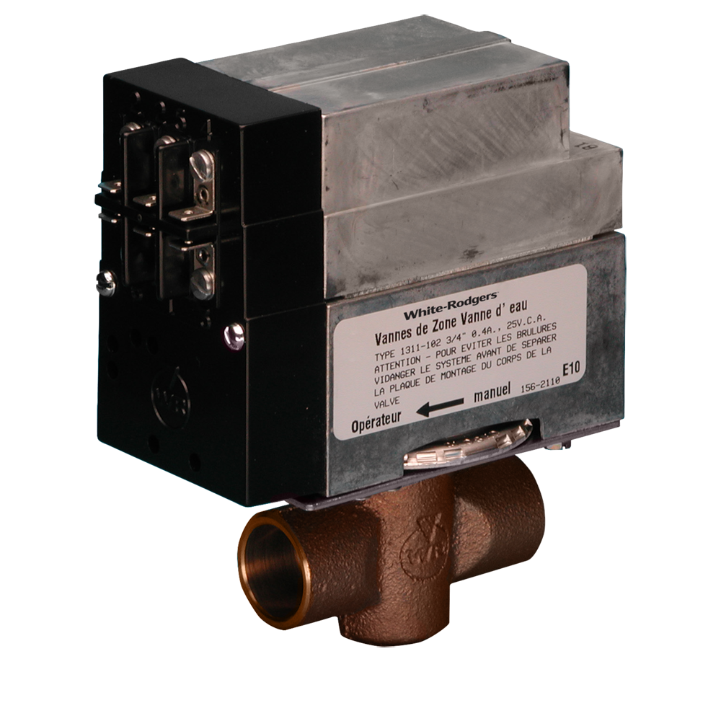
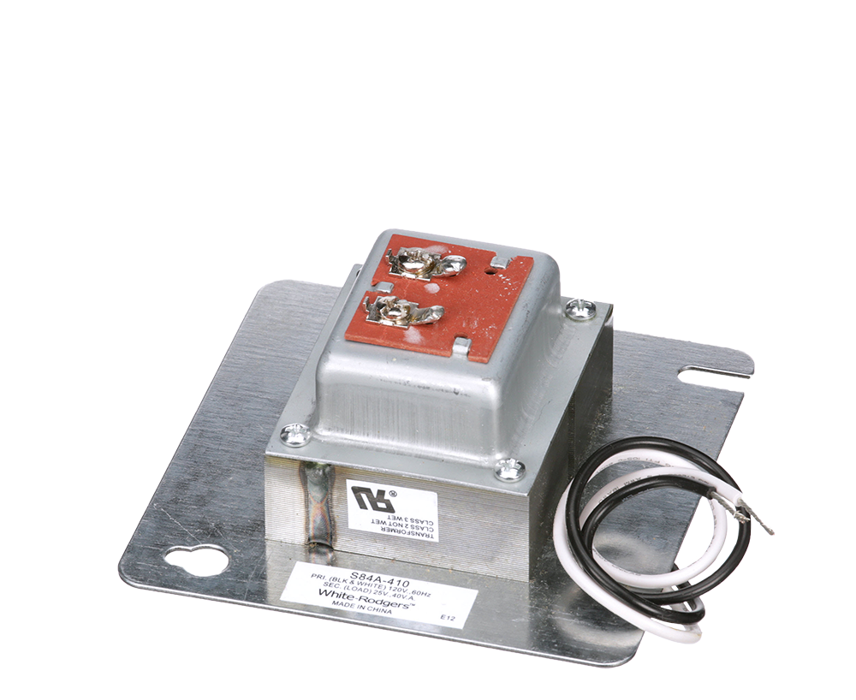
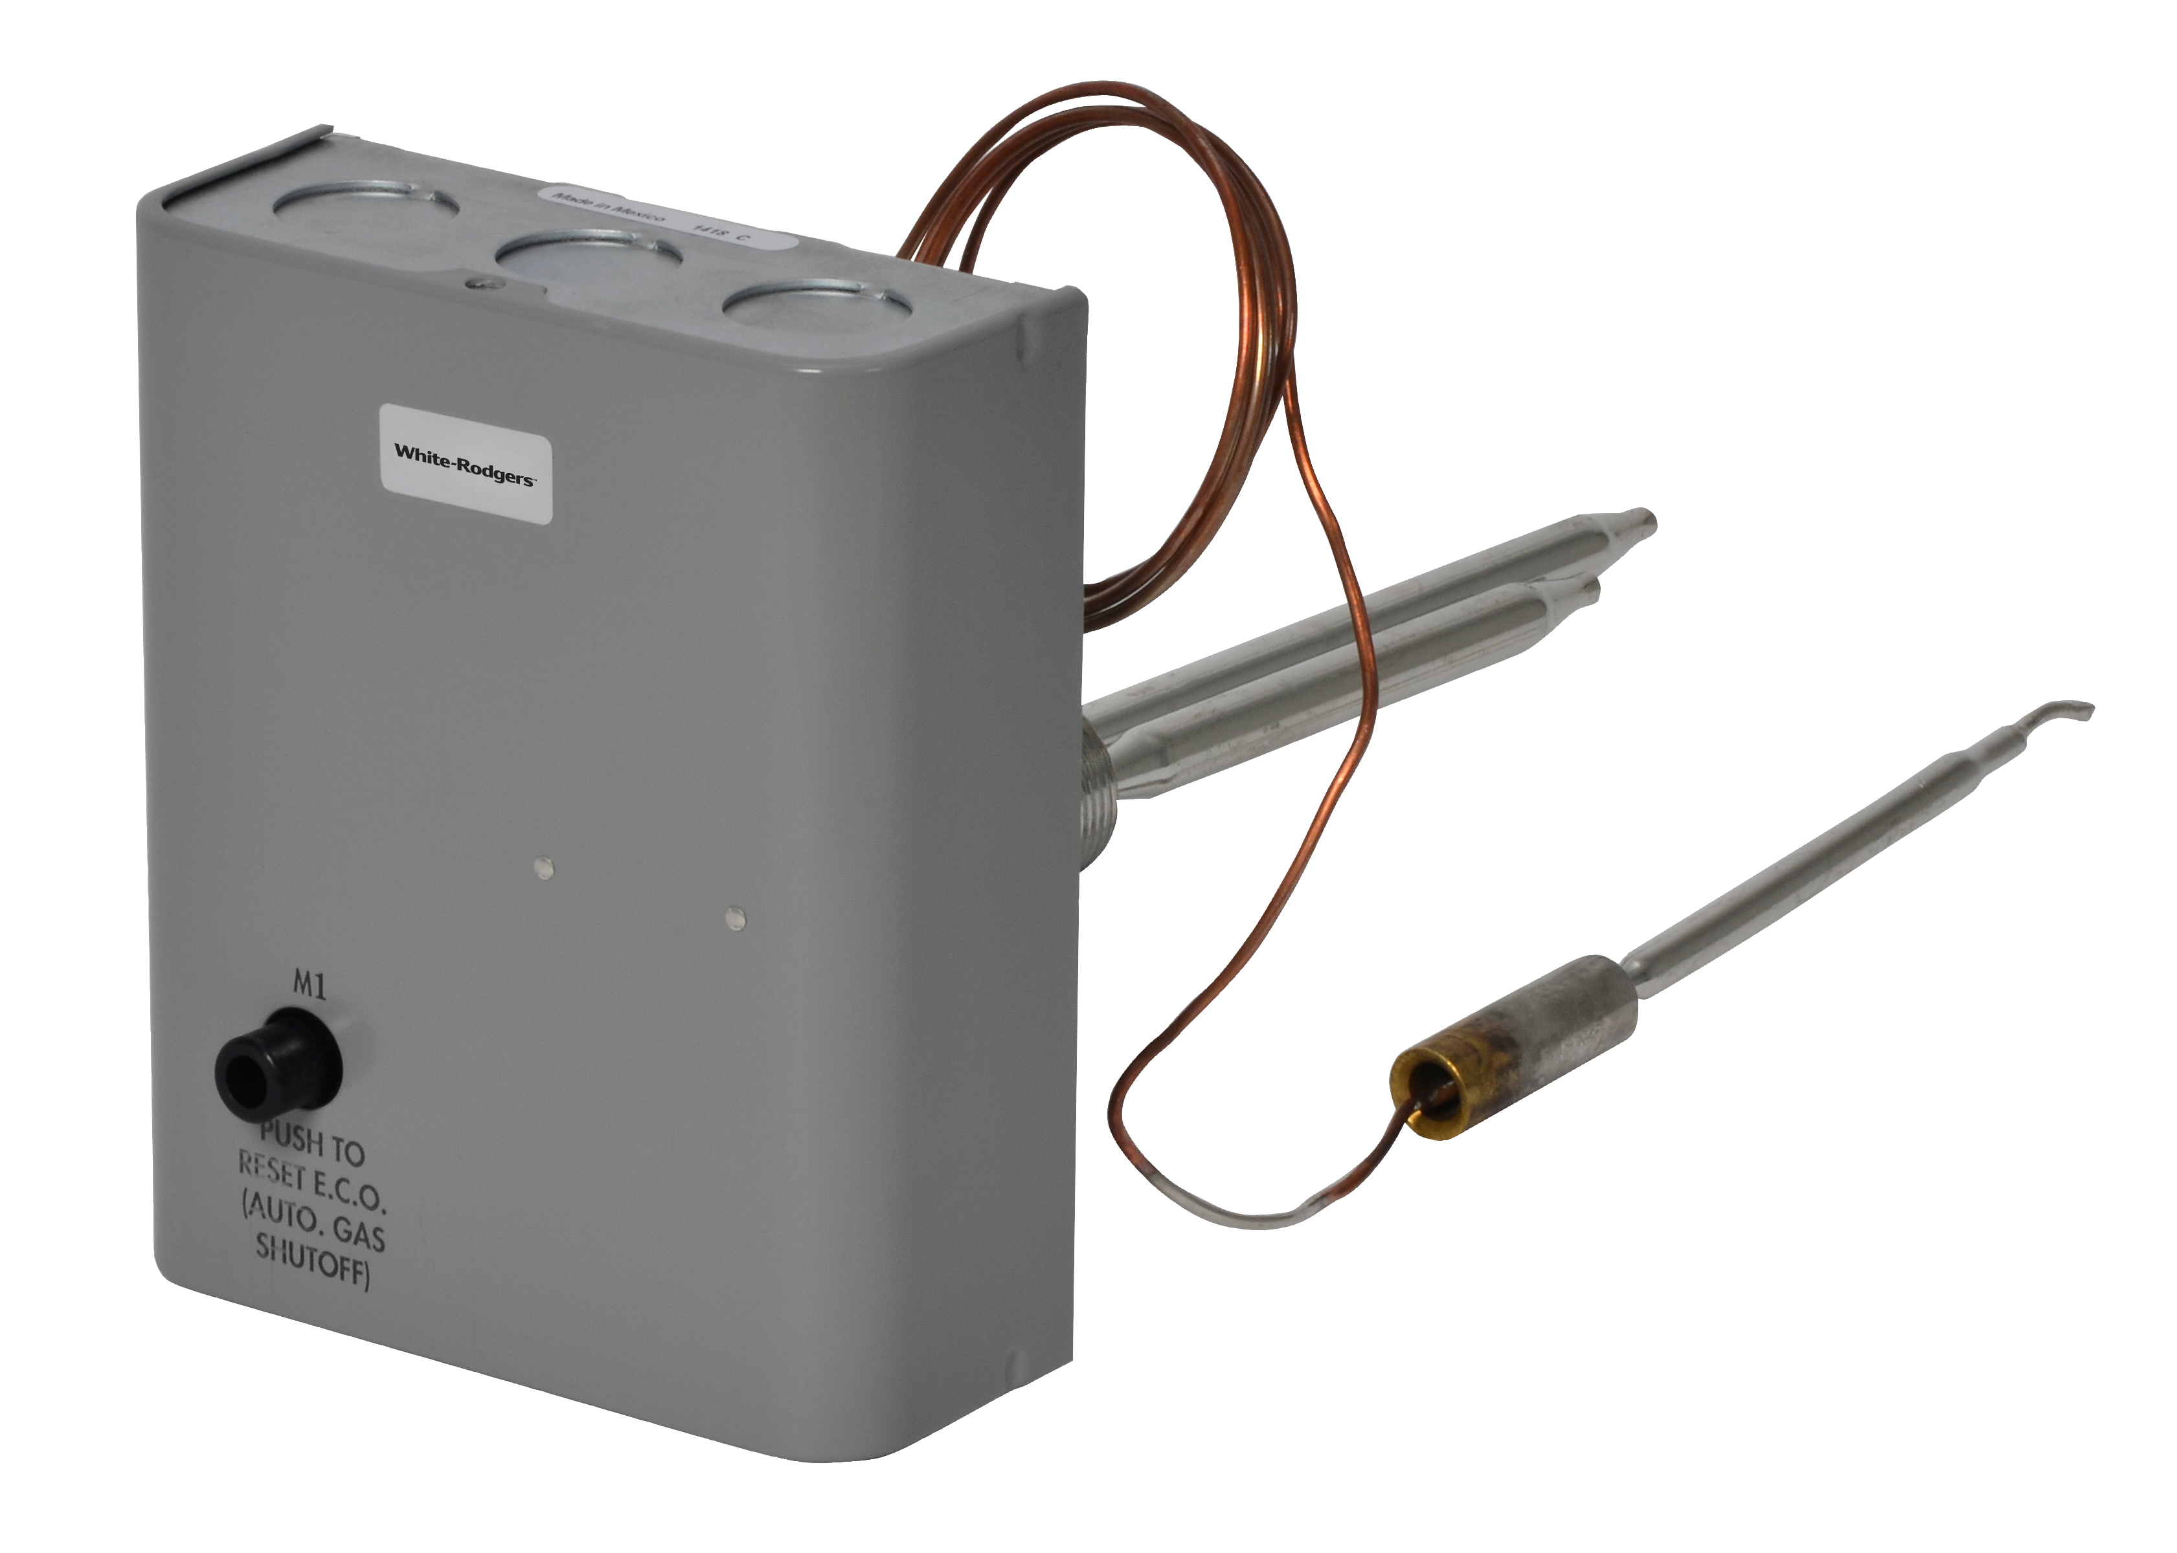
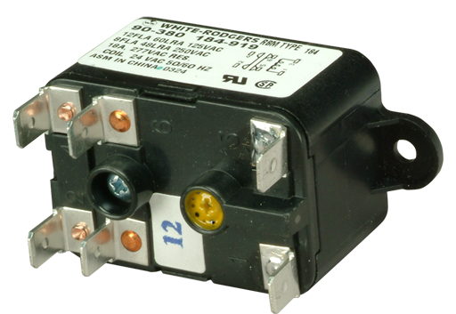
White-Rodgers Heating Controls
Product Group | Description
Standing Pilot Thermocouples and Generators | Standing Pilot Thermocouples
 | Standing Pilot Generators
 | Standing Pilot Generators and Pilot Burners
Outdoor Condenser, Heat Pump, and Air Handler Controls | AC or Heat Pump Controls
 | Heat Pump Defrost Controls
 | Air Handler Controls
Electric Heat Sequencers and Level-Temp Controls | Electric Heat Sequencers
 | Electric Heat Level-Temp Controls
Hydronic Zone Valves and Temperature Controls | Hydronic Zone Valves
 | Hydronic Temperature Controls
 | Hydronic Zone Valve Change-Over Switches
Water Heater Controls | Gas Water Heater Controls
 | Electric Water Heater Thermostats and Limits
Relays and Transformers | Relays
 | Transformers

Slide 4
Combustion Controls Overview
Combustion Control Applications include: unit heaters, wall heaters, floor heaters, boilers, water heaters, commercial roof top and package units, commercial and industrial cooking or process equipment, and gas furnaces for homes, businesses, and commercial buildings.
Forced Hot Air Gas Furnaces
Gas furnaces share many or most of the same types of combustion controls as other gas heating appliances
During the heat cycle, the furnace blower pulls room air across the heat exchanger and distributes heated air to the rooms
The basic sequence of events on call for heat includes – Verifying vent is clear, initiating ignition, controlling gas pressure, verifying flame and delaying the fan circulation on and off

Slide 5
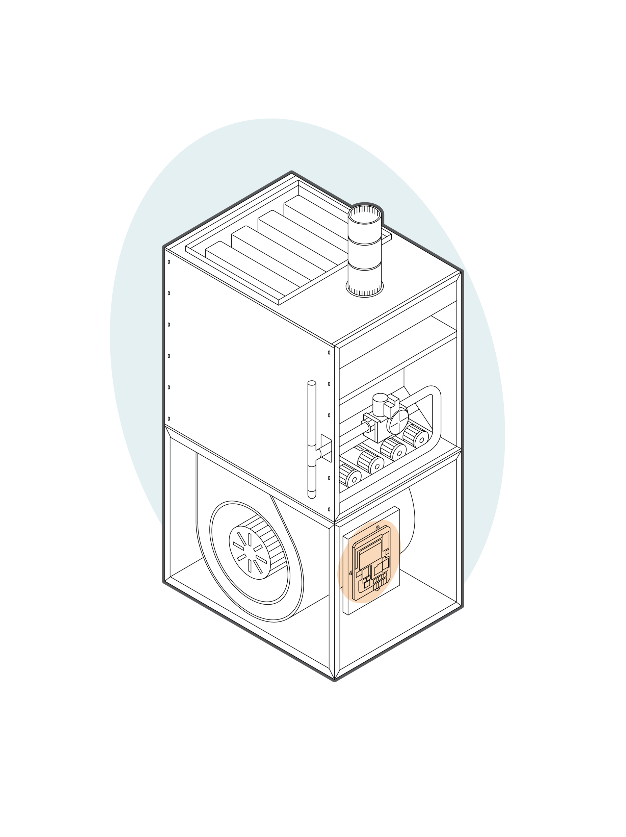
Ignition Controls and Modules Overview
Integrated Furnace Controls
Integrated Furnace Controls provide ignition, proof of ignition, precise control timings and integrated inducer and circulator blower control
Controls are designed for a specific motor type with PSC, Variable Speed, ECM(x) Inducers and Blower motors among the most common
Non-Integrated Ignition Modules
Non-Integrated Ignition Modules provide ignition, proof of ignition and precise control timings. Separate controls in the system provide inducer and blower control

Slide 6
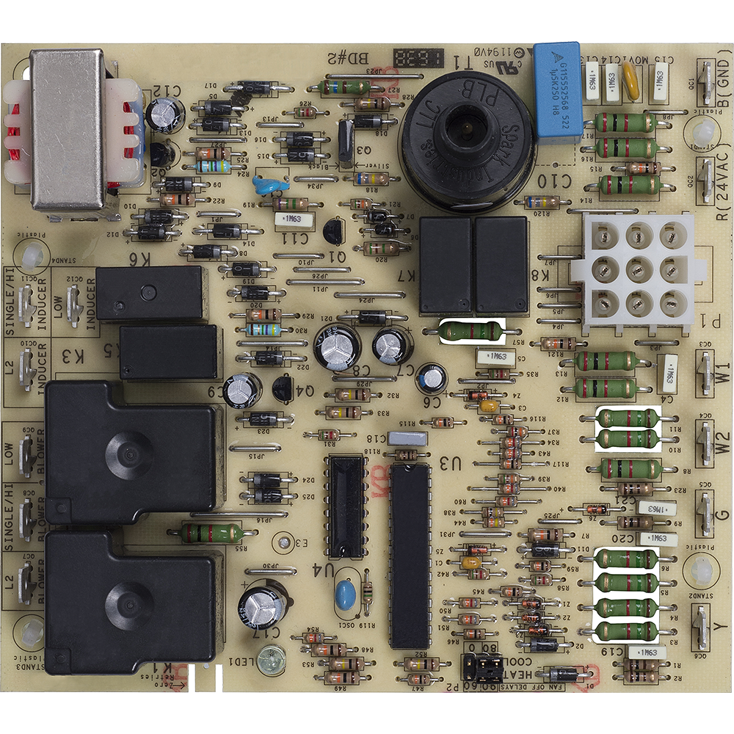
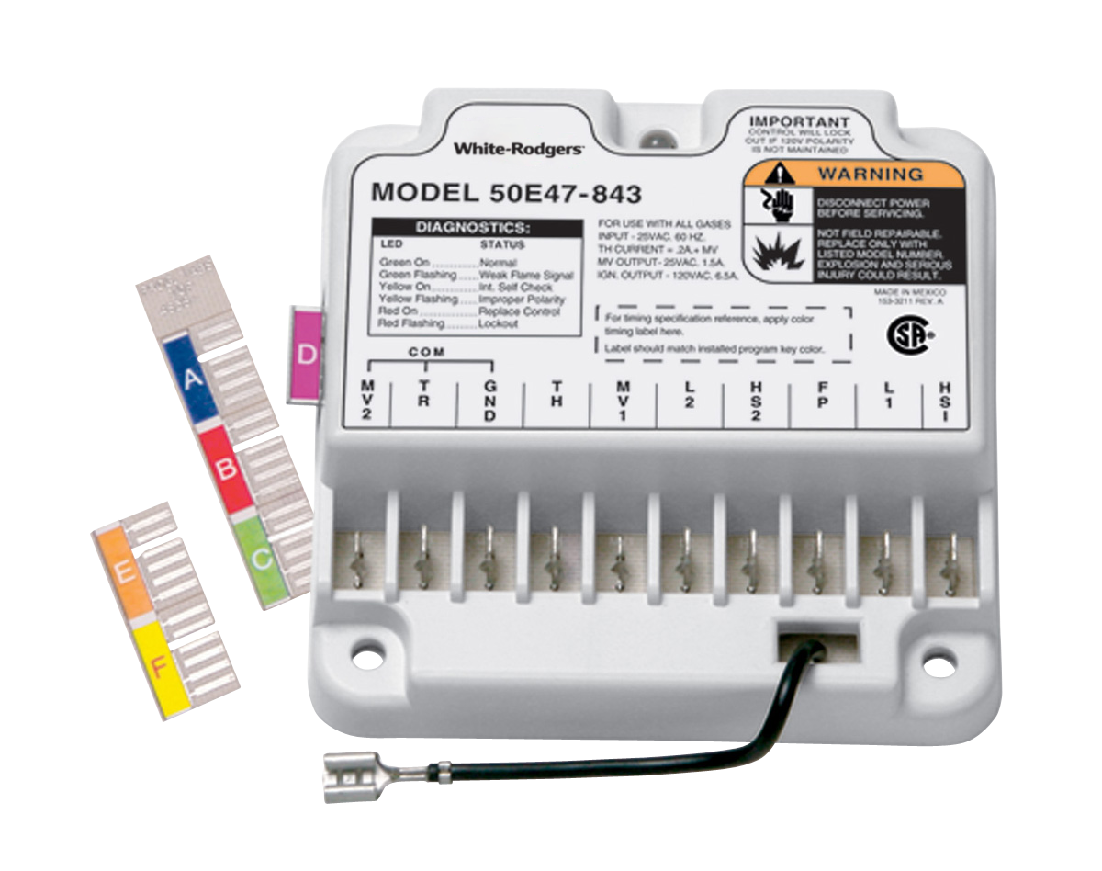
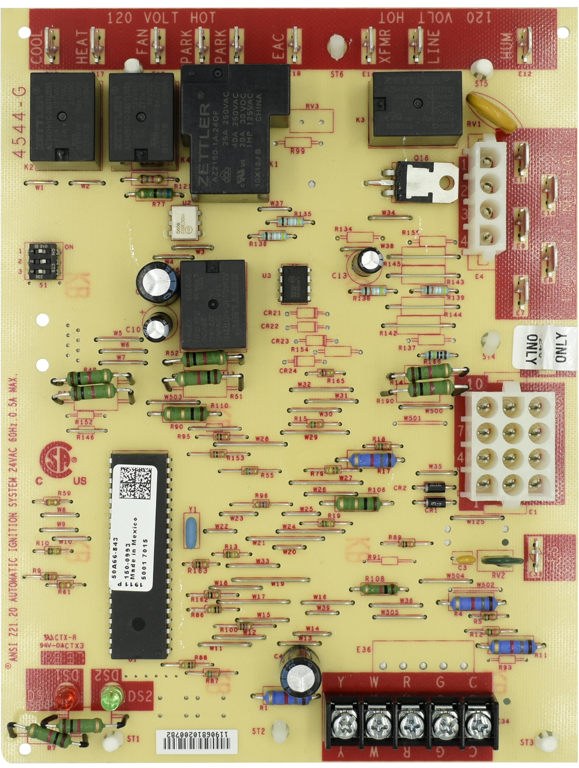
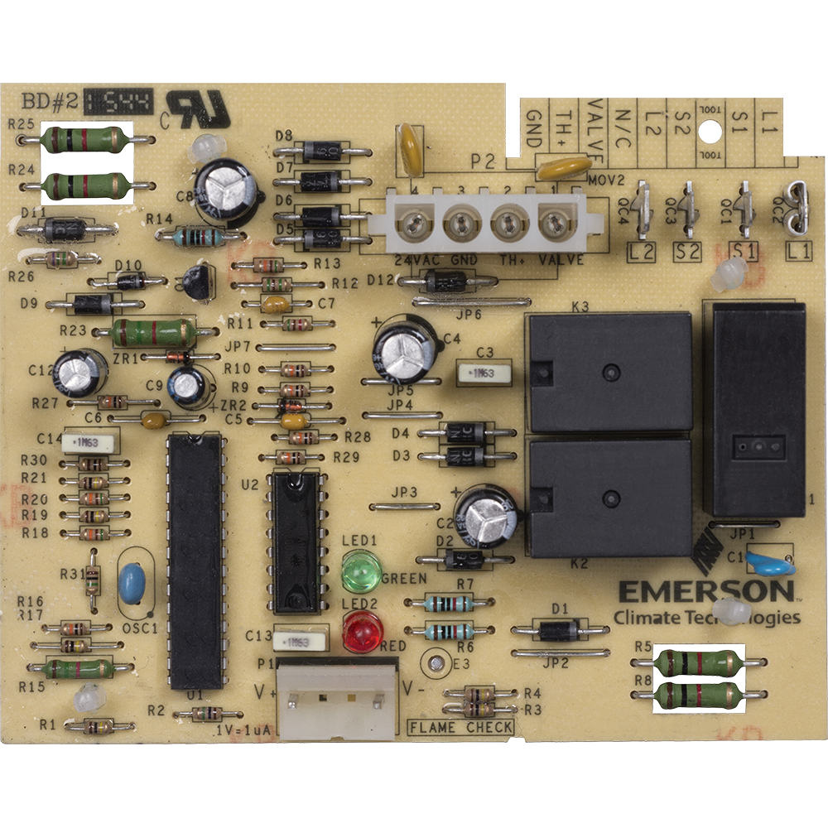
Ignition Controls and Modules
Ignition Types
Hot Surface Ignition directly lights the burner using a hot surface ignitor
Direct Spark Ignition directly lights the burner using spark electrode
Proven/Intermittent Pilot Spark Ignition lights a pilot burner which then lights the main burner
Universal vs. Direct OEM Replacements
Universal models replace multiple brands of original equipment and include wiring harnesses and adjustable timings customizable to multiple applications
Direct OEM replacements are designed for direct drop-in replacement of existing controls
50N02A-820
Integrated Furnace Control (Commercial RTU & Package Unit)
50M56U-843
Integrated Furnace Control (Universal)
50E47-843
Non-Integrated Ignition Modules (Universal)
21D83M-843
Integrated Furnace Control (Direct OEM Replacement)
50E70-820
Non-Integrated Ignition Modules (Commercial RTU & Package Unit)
White-Rodgers Ignition Controls replace
Over 1500 OEM and competitive models

Slide 7
Ignition Controls and Modules – Key Application Features
Key application differences are Ignition Type, Stages, Ignitor Voltage, Motor Types
Replacement Type | Ignition Type | Stages | Ignitor Voltage | Inducer Motor/ Blower Motor | Blower Motor Speed Taps | Thermostat Connections | Model Number
Integrated Furnace Controls
Universal | HSI | Single Stage | 120 Vac | PSC/PSC | Heat, Cool, Fan | R,C,W,Y,G | 50M56U-843
 |  |  |  |  | Heat, Cool |  | 50A55-843
 |  |  |  | PSC/ECMx | Heat, Fan, Hi-Lo | R,C,W,Y,Y/Y2,G,DHUM | 50X57-843
OEM Direct |  |  |  | PSC/PSC | Heat, Cool | R,G,W | 50T35-743
 |  |  | 80 Vac |  | Heat, Cool, Fan | R,C,W,Y,G | 21D83M-843
 |  |  |  |  | Heat, Cool |  | 50A65-5165
Integrated Commercial RTU & Package Unit Ignition Controls
OEM Direct | Direct Spark | Two-Stage |  | PSC/PSC | Hi, Low | R (24 Vac), | 50N02A-820
Non-Integrated Ignition Modules
Universal | HIS | Single Stage | 120 Vac |  | N/A | TH(W),TR(C) | 50E47-843
 | Direct Spark |  |  |  |  |  | 50D50-842
 | Proven/ Intermittent Pilot-Spark |  |  |  |  |  | 50D50-843
Non-Integrated Commercial RTU & Package Unit Ignition Controls
OEM Direct | HIS | Single Stage | 120 Vac | PSC/PSC | N/A | System 4-Pin | 50E70-820

Slide 8
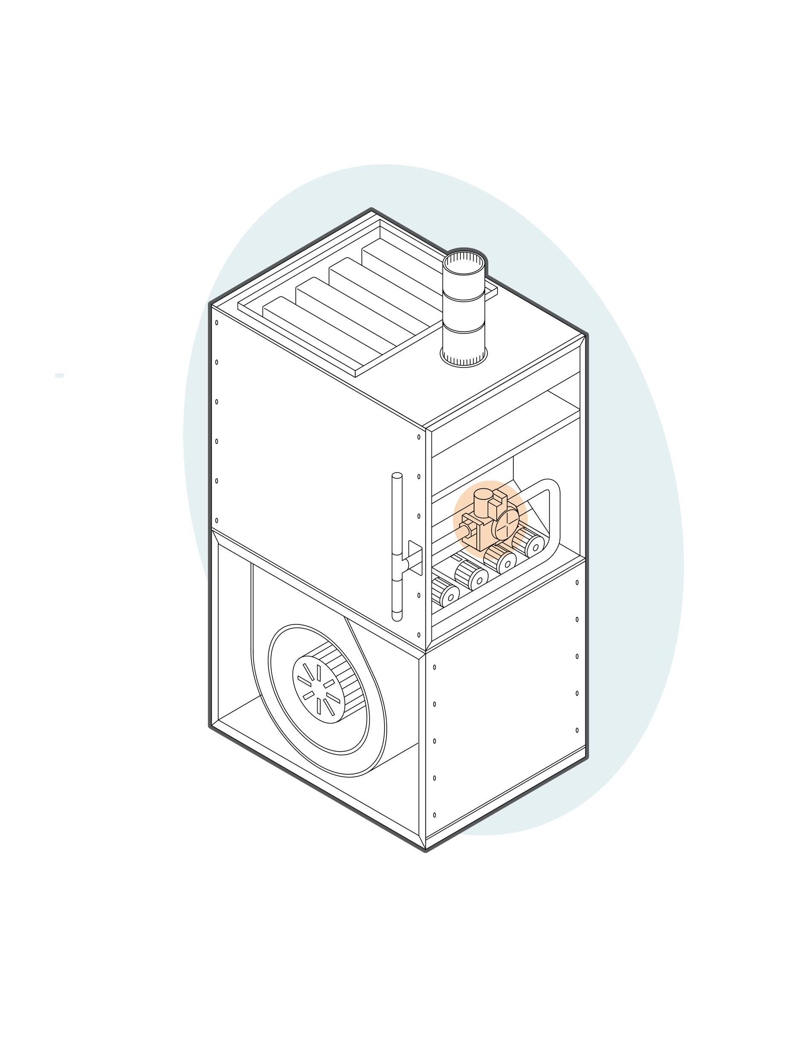
Gas Valves Overview
Gas valves typically combine multiple functions for safe, efficient, and reliable combustion control.
Valves come in a range of pipe sizes and BTU capacities to match applications from residential fireplaces to furnaces to industrial boilers.
Multiple functions may include a manual shutoff, burner pressure regulation, low fire/high fire staging, pilot flame safety control and multiple (redundant) valves for added safety.
Valve opening characteristics can provide fast/standard open, slow open, step open and modulating gas control allowing quiet ignition and improved combustion efficiency.

Slide 9
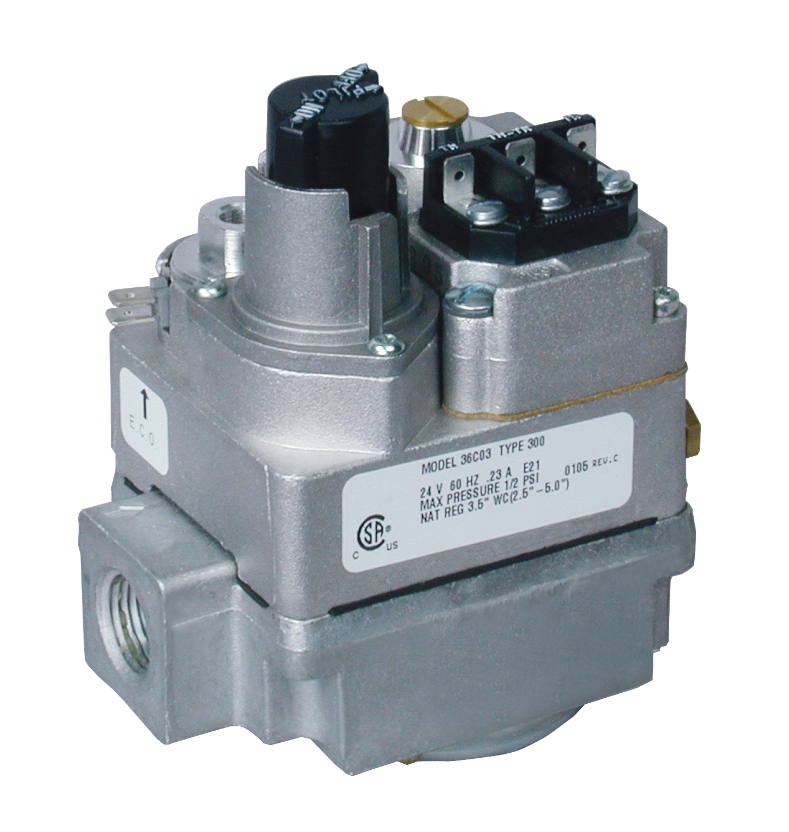
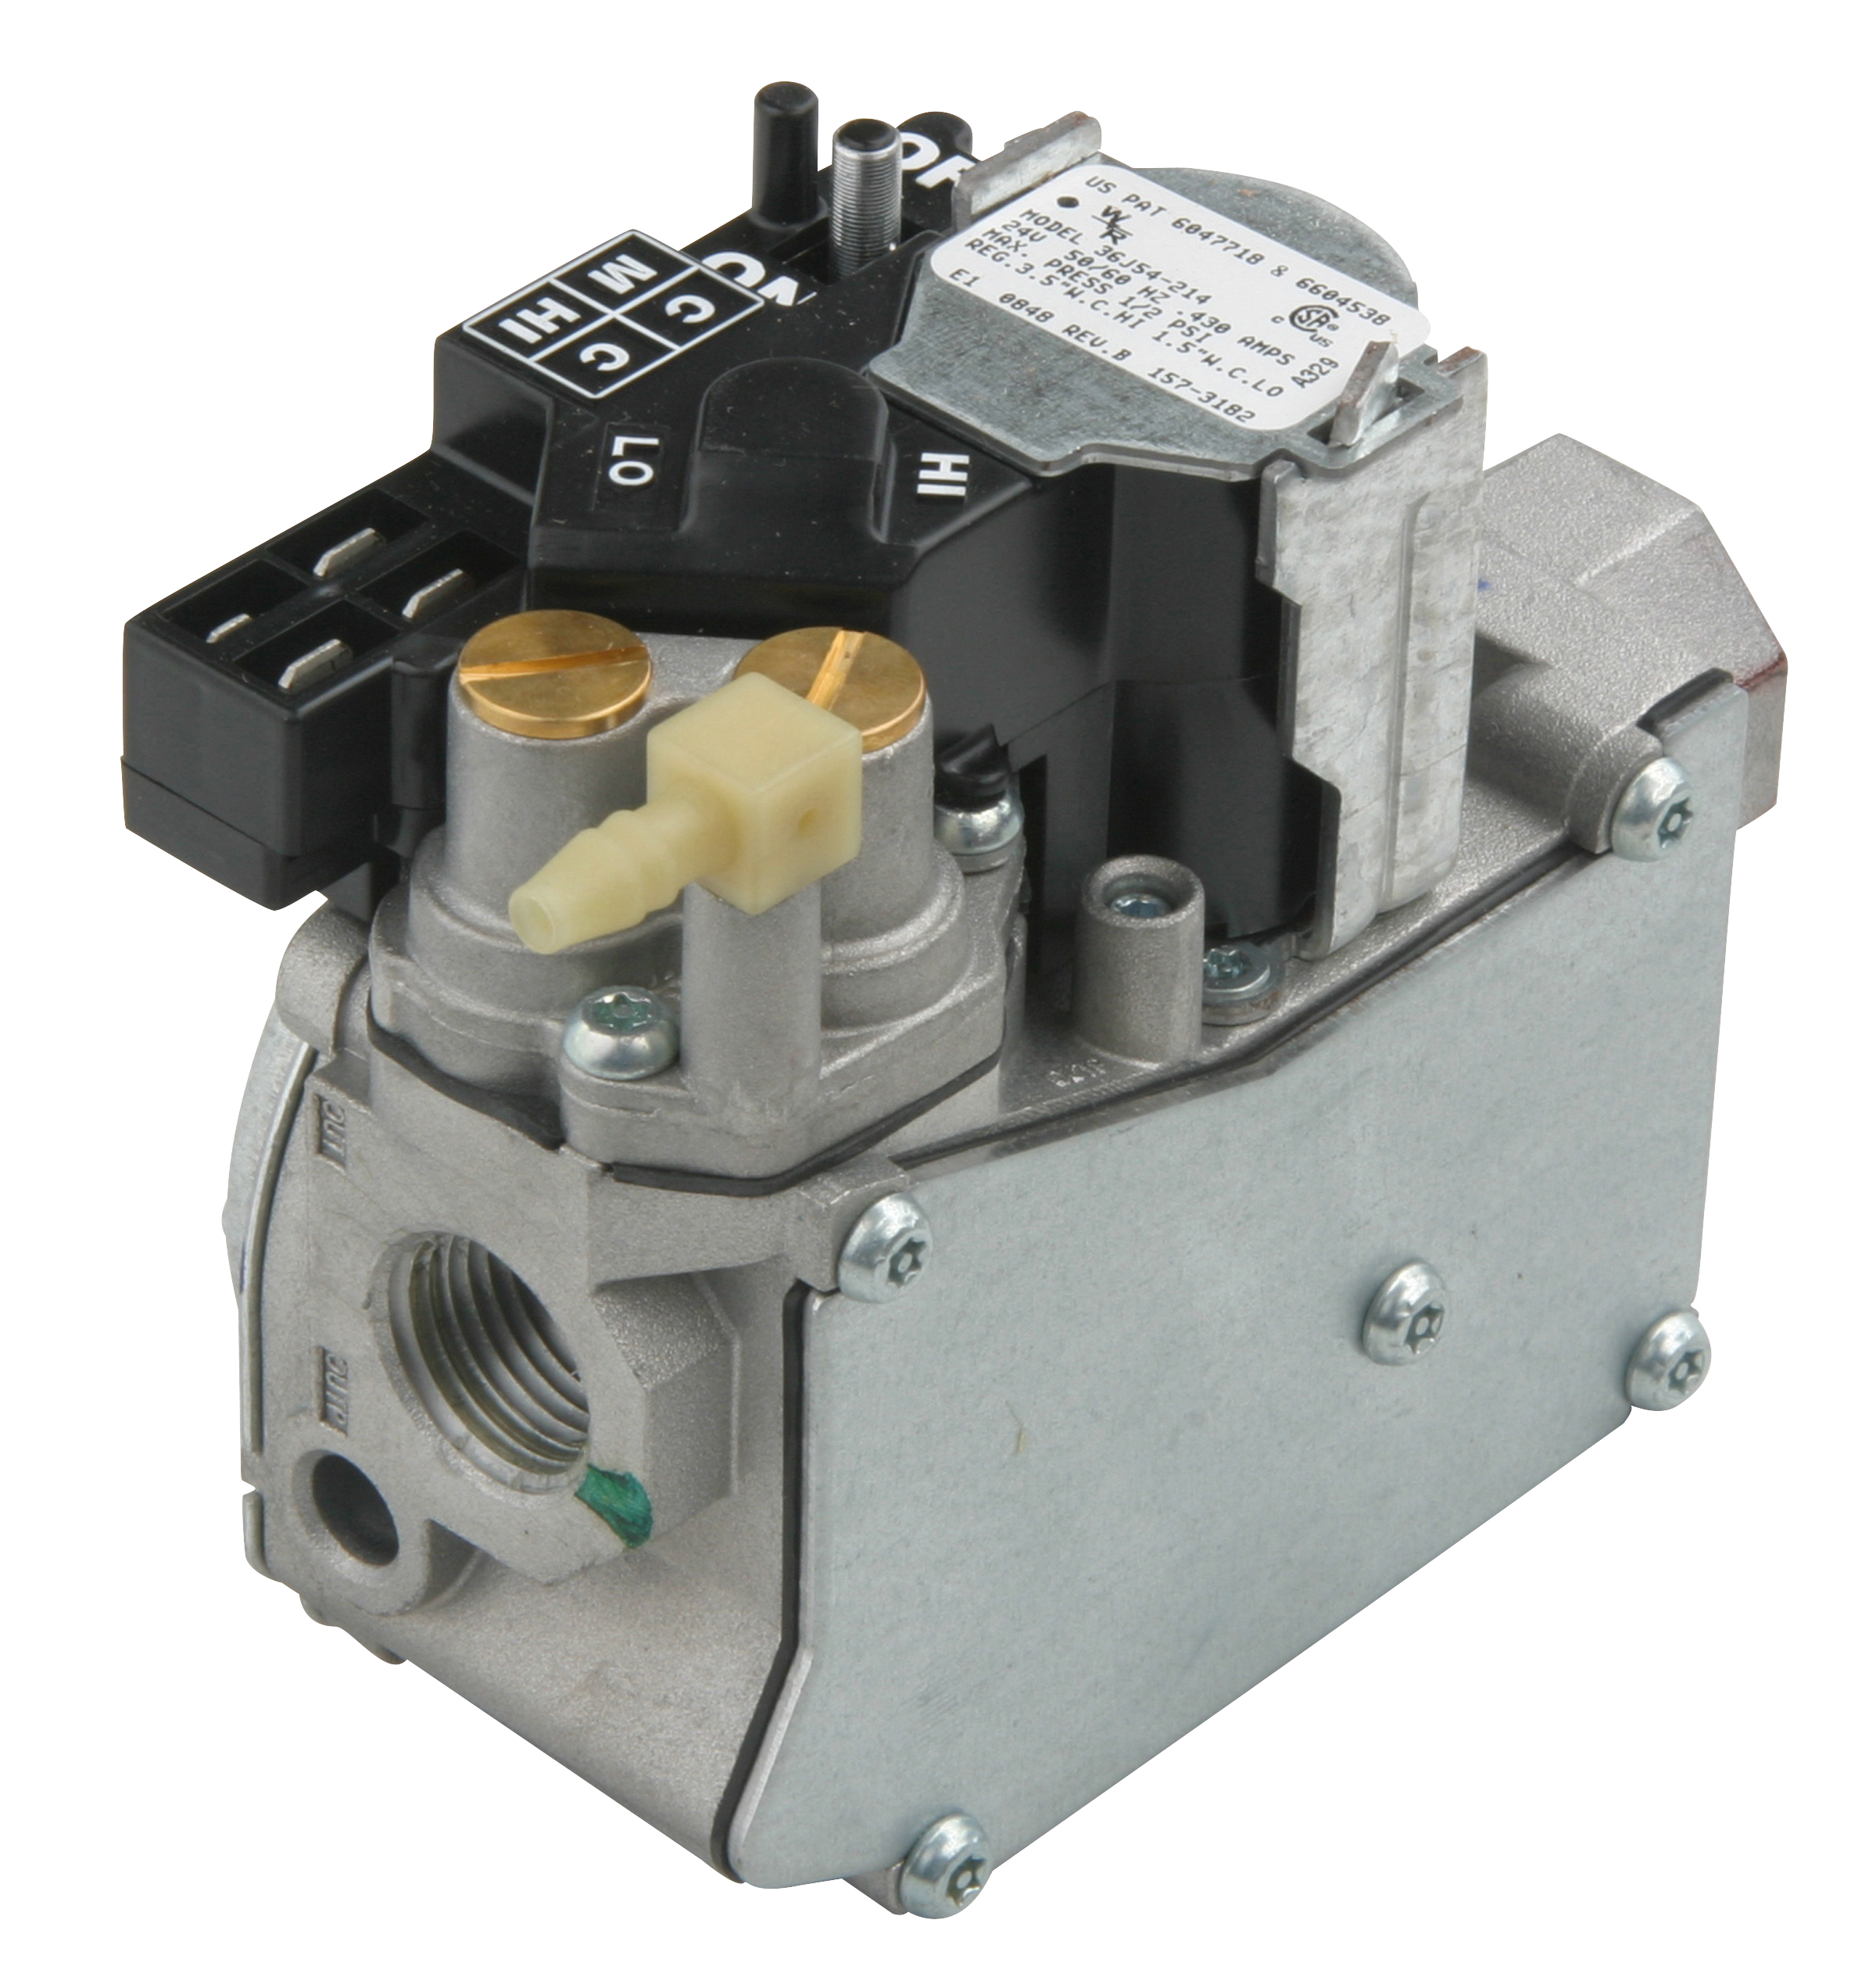
Gas Valves
36C Series
Standing pilot and intermittent/proven pilot ignition models
Millivolt, 24 and 120 Volt models
Fast/Standard and Slow Open
36G/J Series
Hot Surface Ignition (HSI), Direct Spark Ignition (DSI) and intermittent/proven pilot ignition styles
24 Volts
Single and two stage, fast/standard and slow open and modulating
36C03-300
Standing Pilot Gas Valve
36G32-500
HSI, DSI Intermittent/Proven Pilot Gas Valve
36J54-214
HSI/DSI Gas Valve

Slide 10
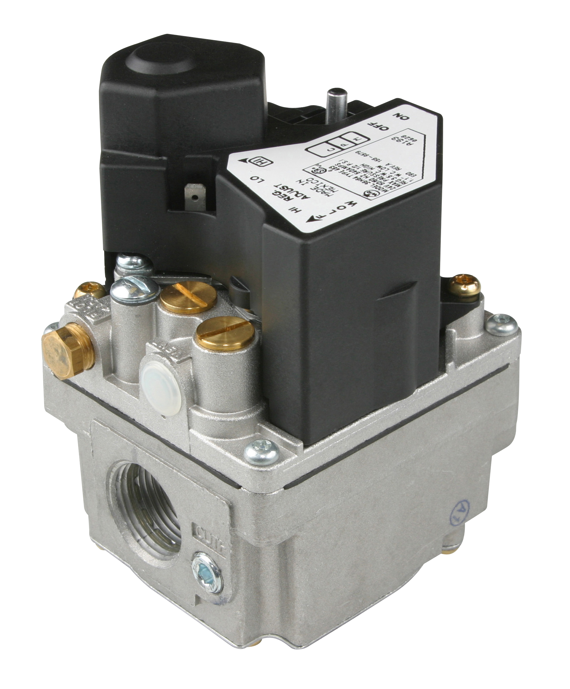
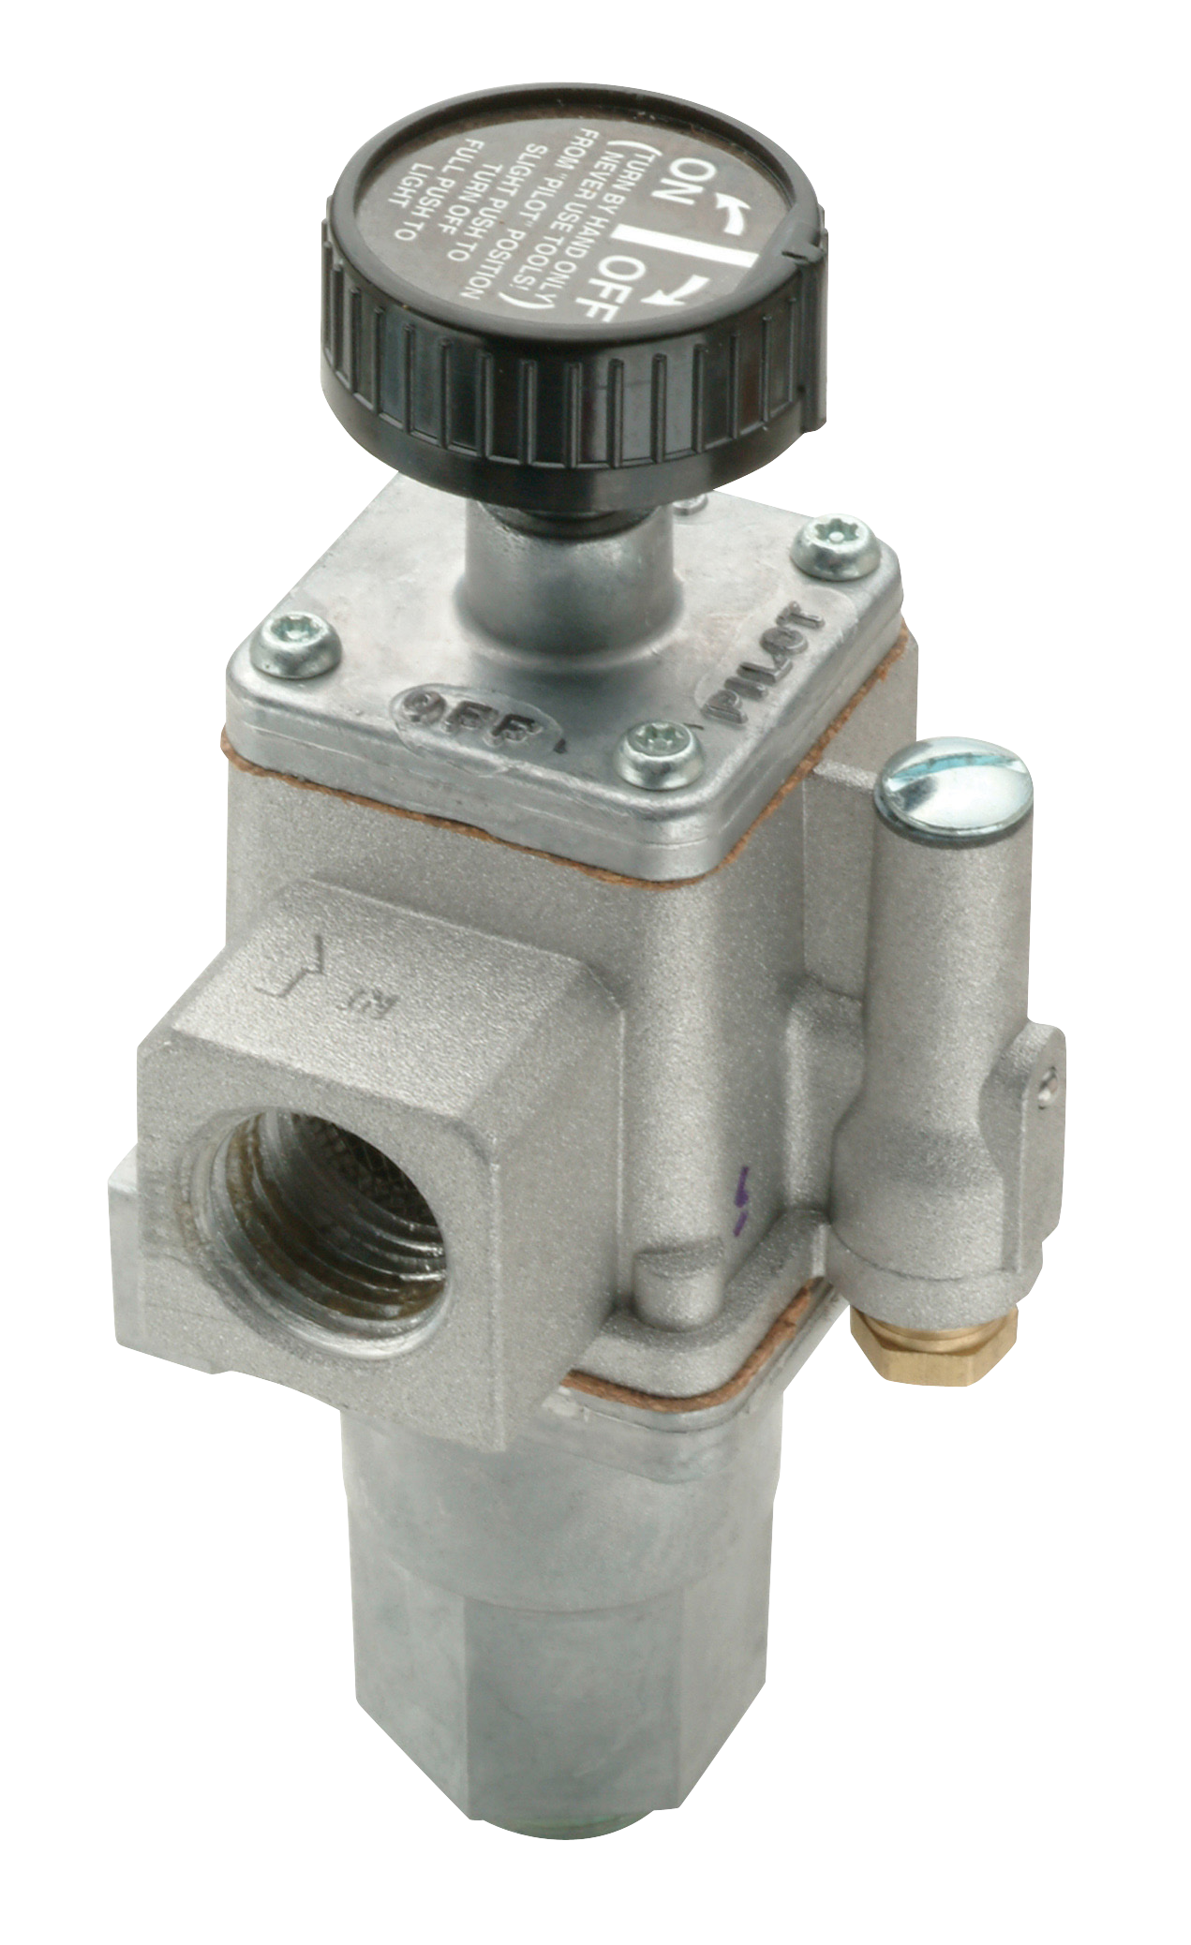
Gas Valves
36H Series
Hot Surface Ignition (HSI), Direct Spark Ignition (DSI) and intermittent/proven pilot
24 Volts
Single and two stage, fast/standard and slow open
764 Series
Standing pilot safety/fireplace valves
mV pilot safety
On/Off/Pilot control
36H64-463
HSI, DSI Intermittent/Proven Pilot Gas Valve
764-742
Pilot Safety/Fireplace Valve
White-Rodgers Gas Valves replace
Over 3300 OEM and competitive models

Slide 11
Gas Valves – Key Application Features
Control Type | Voltage | Stages | Opening Style | Inlet x Outlet Size and Flow Direction | Regulator Adjustment | 1” Pressure Drop Capacity | Regulation Range | Model Number
36C Series Gas Valves
Standing Pilot with Line Interrupter | 24 Vac, 60 Hz | Single Stage | Fast Opening | 1/2”x3/4” NPT, Straight Thru | Nat. 2.5-5.0”, LP 7.5-12.0” | Nat. Gas 230,000, LP 372,600 | Nat. Gas 30,000-290,000, LP 30,000-469,000 | 36C03-300
Intermittent/Proven Pilot |  |  | Delay Slow Opening |  |  |  |  | 36C94-303
36G/J Series Gas Valves
HIS, DSI, Intermittent/Proven Pilot | 24 Vac, 50/60 Hz | Single Stage | Slow Opening | 1/2”x1/2” NPT or Flange Mount, Straight Thru | Nat. 2.5-5.0”, LP 7.0-12.0” | Nat. Gas 140,000, LP 226,600 | Nat. Gas 40,000-210,000, LP 60,000-340,000 | 36G33-500
HIS, DSI |  | Two-Stage | Fast Opening | 1/2”x1/2” NPT Straight Thru | Nat. 1.0-4.0” Low, 2.0-5.0 High, LP 4.0-10.0” Low, 6.0-12.0” High | Nat Gas 140,000, LP 226,800 | Nat. Gas 20,000 Low-210,000 High, LP 32,000 Low-340,000 High | 36J54-214

Slide 12
Gas Valves – Key Application Features Cont.
Control Type | Voltage | Stages | Opening Style | Inlet x Outlet Size and Flow Direction | Regulator Adjustment | 1” Pressure Drop Capacity | Regulation Range | Model Number
36H Series Gas Valves
HIS, DSI, Intermittent/Proven Pilot | 24 Vac, 50/60 Hz | Single Stage | Fast Opening | 1/2”x3/4” NPT, Straight Thru | Nat. 2.5-5.0”, LP 5.0-12.0” | Nat. Gas 230,000, LP 372,600 | Nat. Gas 50,000-300,000, LP 80,000-500,000 | 36H32-304
Control Type | Voltage | Inlet x Outlet Size | 1” Pressure Drop Capacity | Model Number
764 Series Fireplace/Pilot Safety Gas Valves
Standing Pilot with Line Interrupter | 20-30 mV Thermocouple | 1/2”x1/2” NPT Dual Inlet Str. Thru with Optional Bottom Inlet | Nat. Gas Side Inlet 124,000 Bottom 118,000, LP Side Inlet 200,880 Bottom 191,160 | 764-742

Slide 13
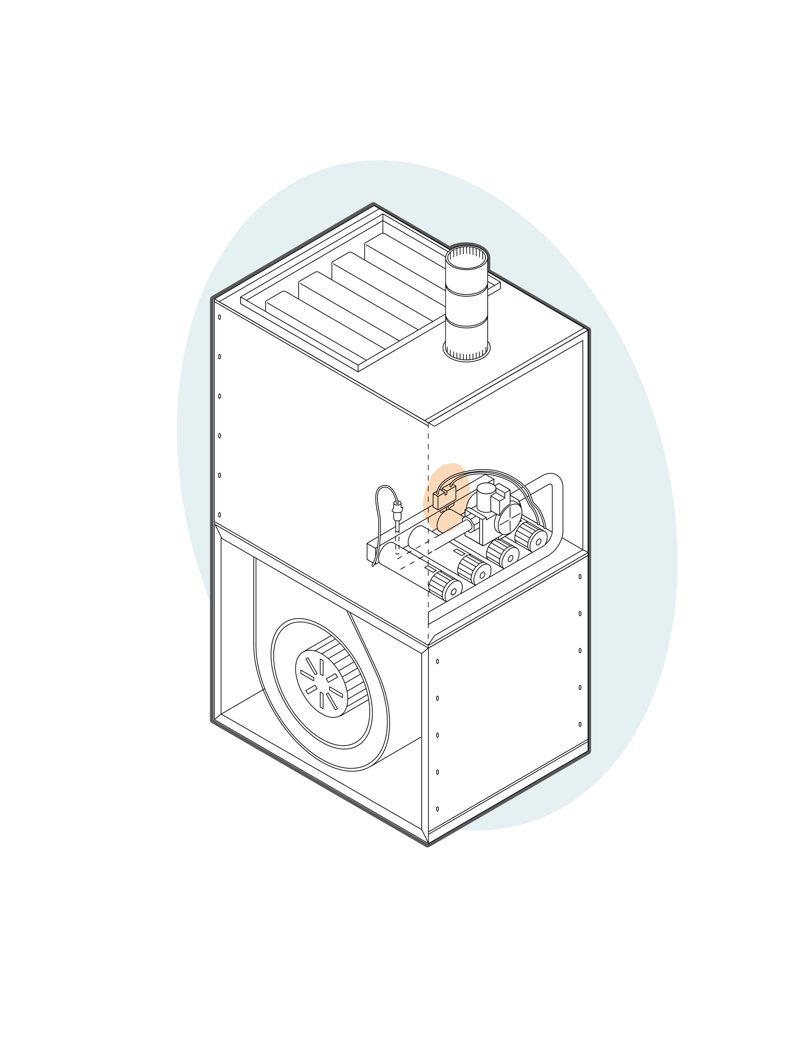
Hot Surface Ignitors Overview
Hot Surface Ignitors are used in a wide range of combustion appliances to directly ignite the gas burner.
Electrical power to a hot surface ignitor heats it to over 1100°
After warm-up the gas valve opens and the ignitor instantly ignites the main burner
Once the gas is lit, power to the ignitor drops out until the next combustion cycle
White-Rodgers Hot Surface Ignitors replace over 800 OEM and competitive models

Slide 14
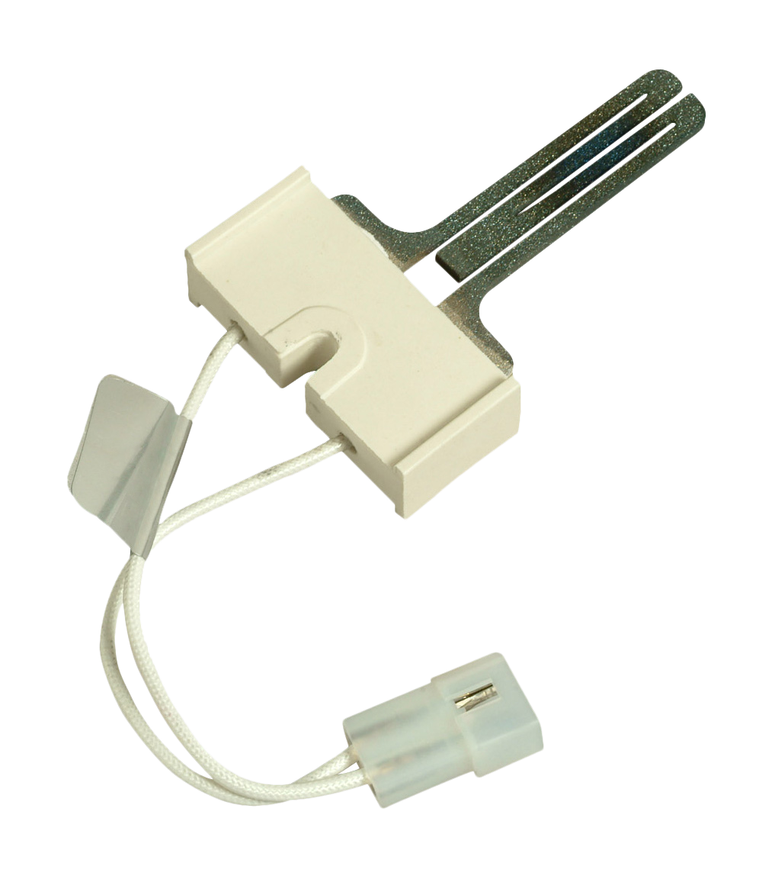
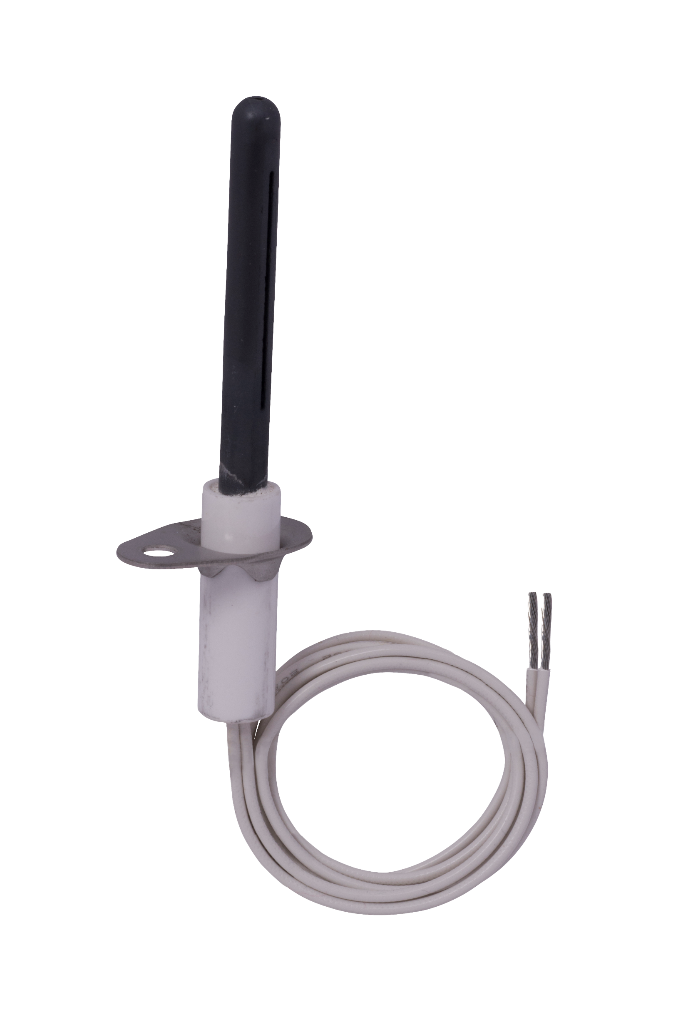
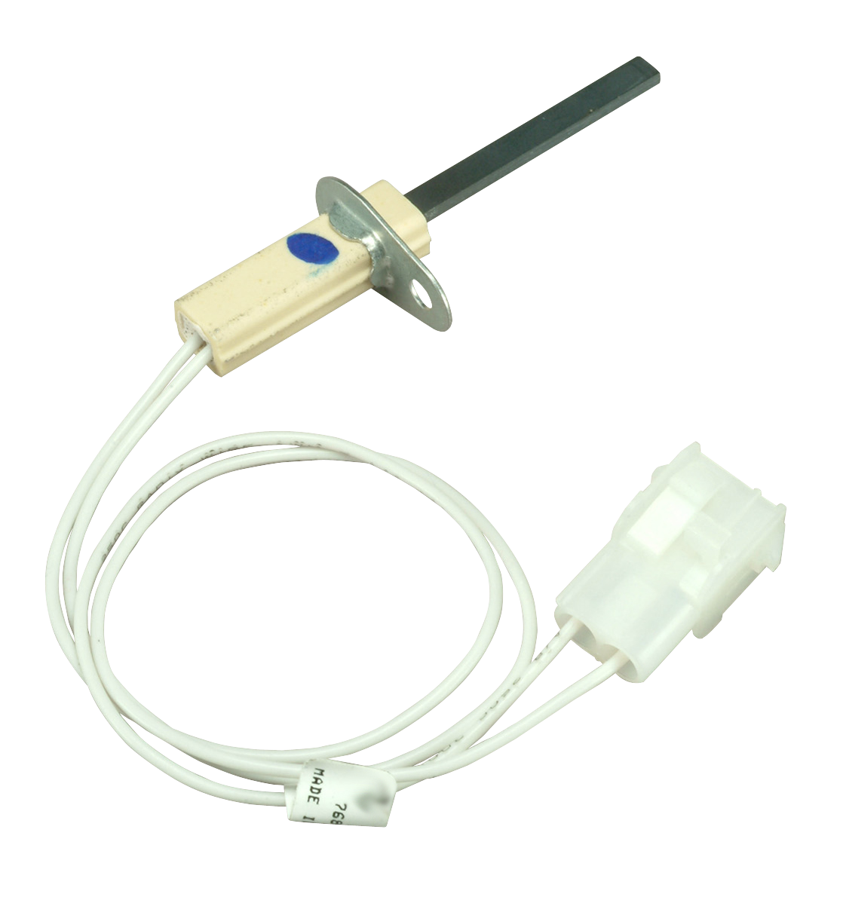
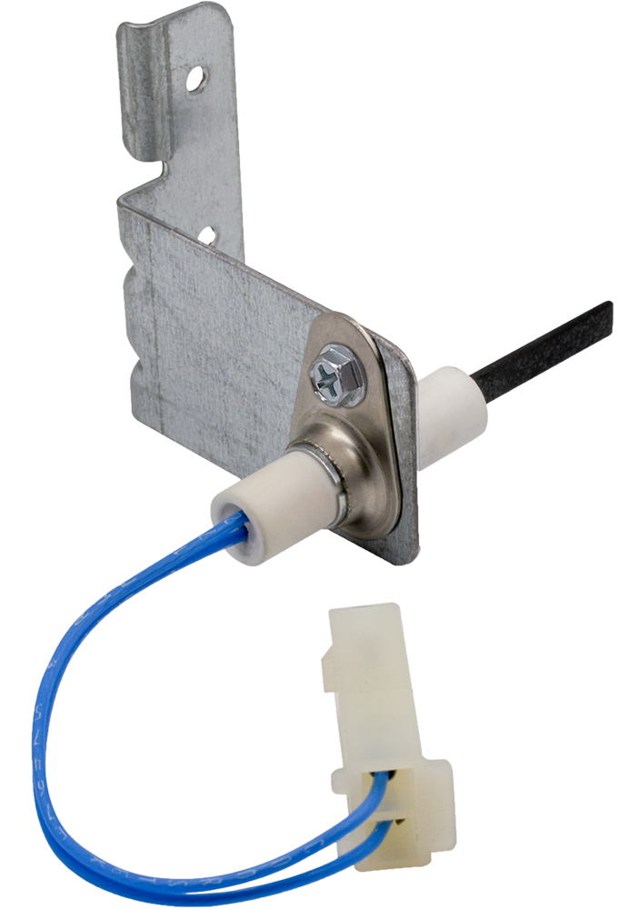
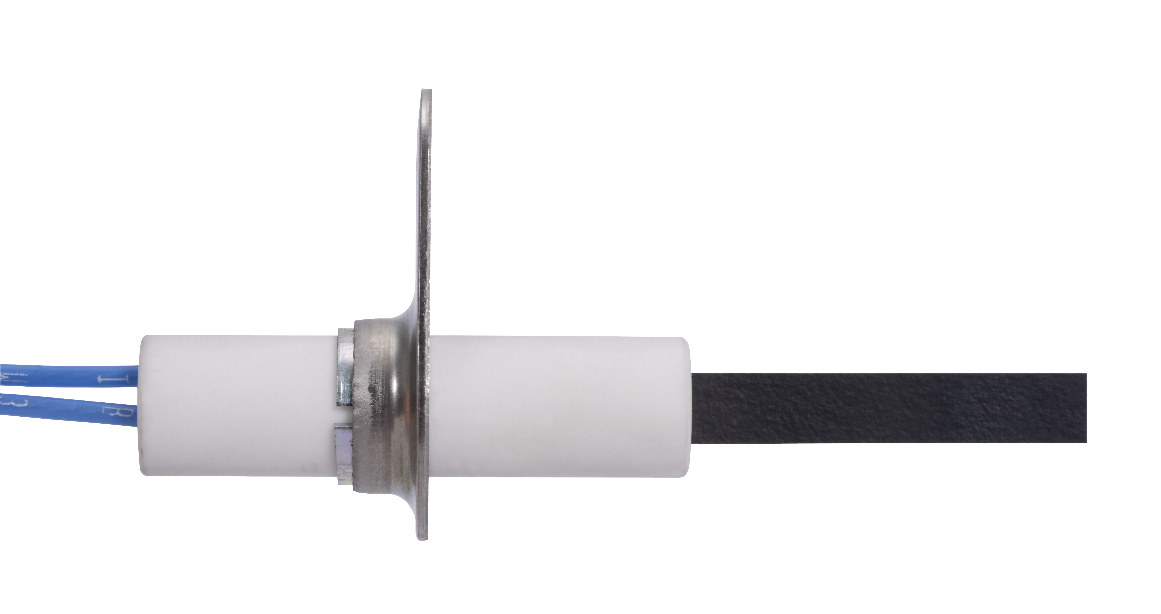
Hot Surface Ignitors
Universal Nitride Upgrade Ignitor Kits
Replaces and upgrades 120 Volt carbide hot surface ignitors to more rugged/durable silicon nitride
120 Volt Silicon Carbide Hot Surface Ignitors
First generation standard carbide ignitors offered more reliable ignition than competing direct spark ignition systems
120 Volt Silicon Nitride Hot Surface Ignitors
Latest generation direct replacement OEM nitride styles
80 Volt Nitride Hot Surface Ignitors
First generation lower voltage direct replacement nitride styles
767A-370
Silicon Carbide Ignitor
21D64-2
Hotrod Universal Ignitor
768A-844
Silicon Nitride Ignitor
789A-820
Silicon Nitride Ignitor
21D64-44
HotRod EX Universal

Slide 15
Hot Surface Ignitors - Key Application Features
Key application differences Universal and Direct OEM Replacement
Brands Replaced | Ignitor Voltage | Lead Length | Connections | Model Number
120x Nitride Upgrade Ignitor Kits-Universal
All Brands | 120 Vac | 15.5” | Ceramic Wire Nuts | 21D64-2
 |  |  |  | 21D64-44
120 Volt Silicon Carbide Hot Surface Ignitors-Direct OEM Replacement
Carrier, Trane, Rheem | 120 Vac | 5.25” | Receptacle with .093” Male Pins | 767A-370
Goodman, York, Nordyne, Trane, Amana, Armstrong |  | 19.13” | Stripped Ends | 767A-371
Rheem, Lennox, Trane |  | 5.25” | Molex Side Lock Connector with .092” Male Pins | 767A-372
120 Volt Silicon Nitride Hot Surface
Lennox, Rheem | 80 Vac | 12” | 2 Terminal AMP Receptable, .084” Female Sockets | 768A-844
Trane |  | 5” | 2 Terminal AMP Receptable, .083” Female Sockets | 768A-815
 |  |  | 2 Terminal AMP Receptable, .084” Female Sockets | 768A-845
80 Volt Nitride Hot Surface Ignitors-Direct OEM Replacement
Carrier | 120 Vac | 9.25” | Molex Connector | 789A-751A1
Lennox |  |  |  | 789A-801A1
Trane |  | 4.25” |  | 789A-820

Slide 16
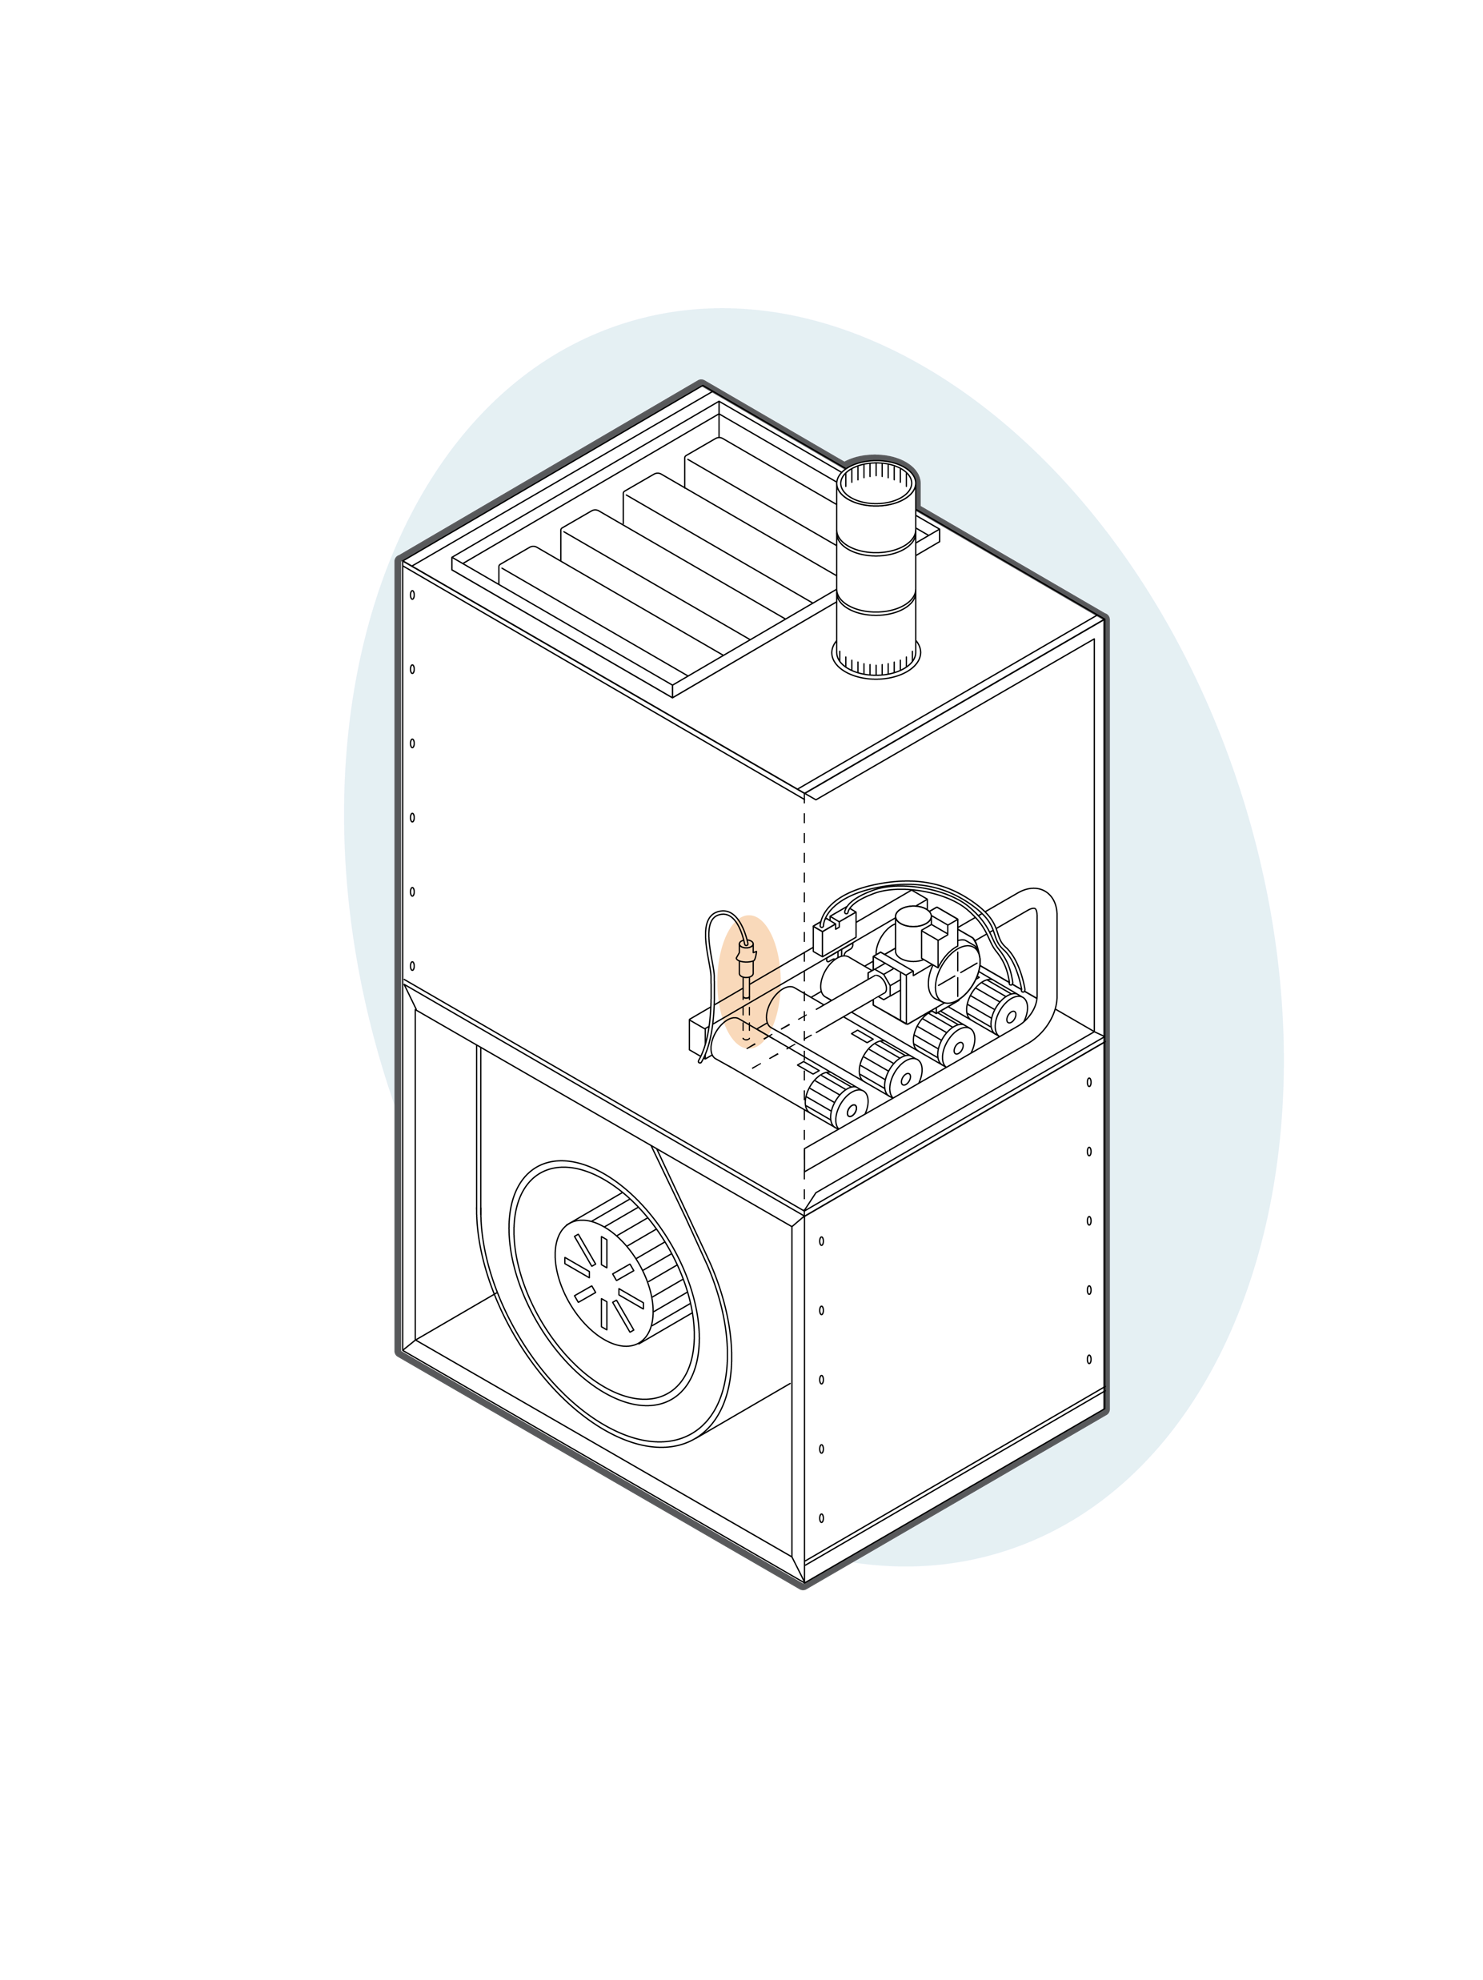
Flame Sensors
Flame Sensors mount on the burner rack or frame and provide a signal to the ignition control or module indicating flame presence.
Flame sensors register flame presence (or absence) almost instantly
When the gas valve opens and flame is not detected within a few second safety time the ignition control or module shuts the gas off, purges the combustion chamber and then retries
Carbon build-up, a bent, misaligned sensor or shorted sensor lead results in an immediate “no heat” condition

Slide 17
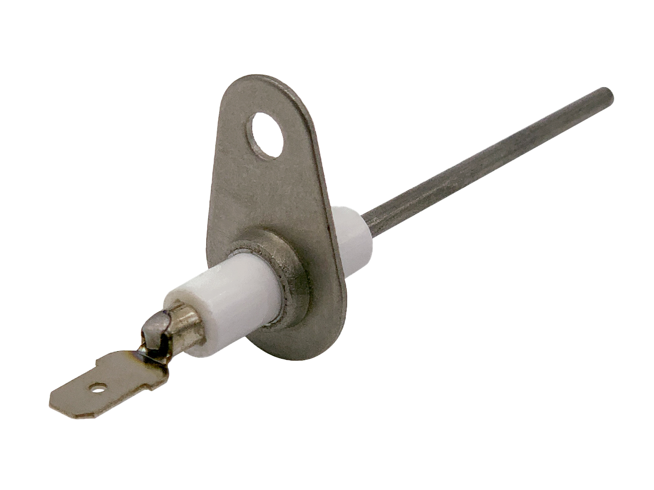
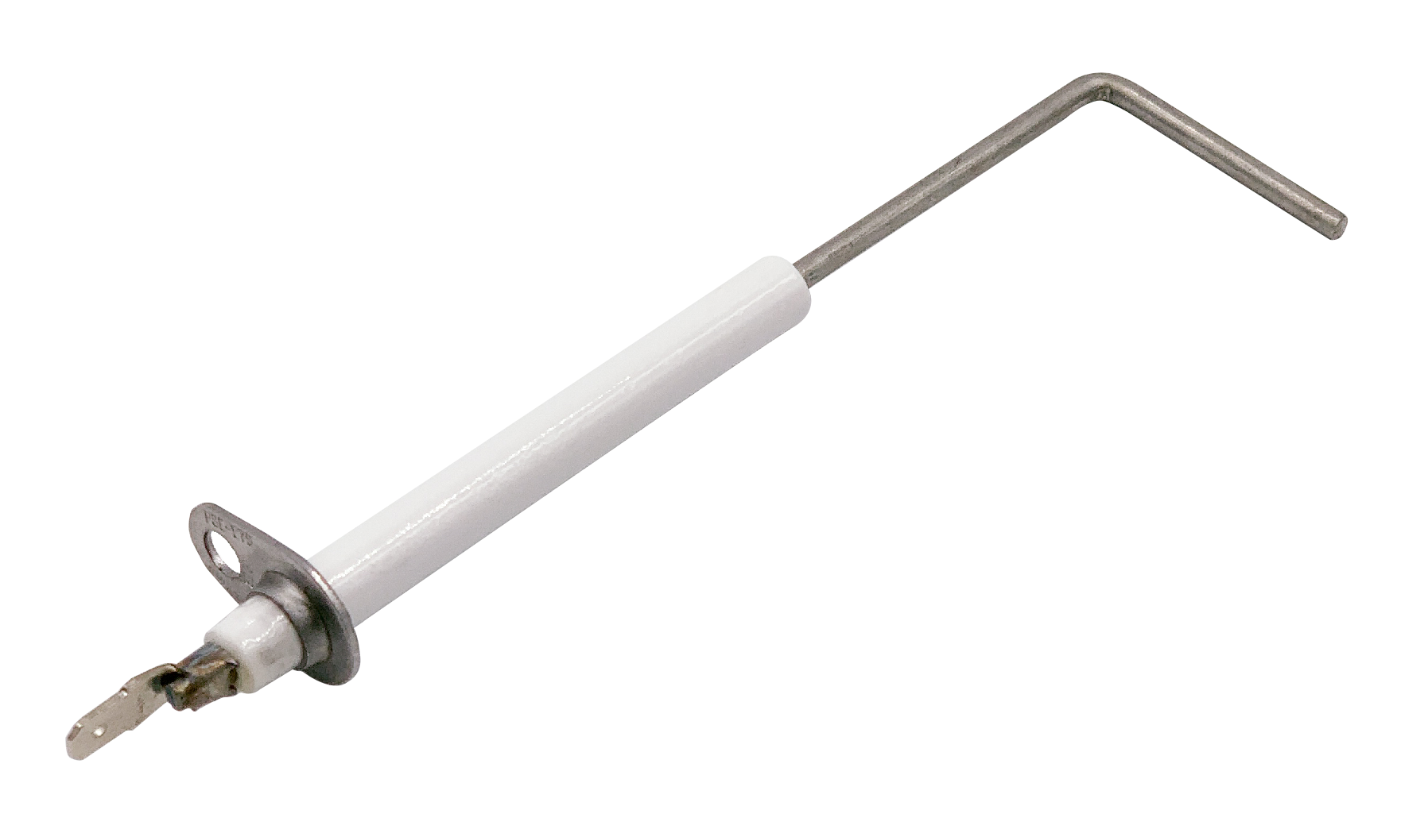
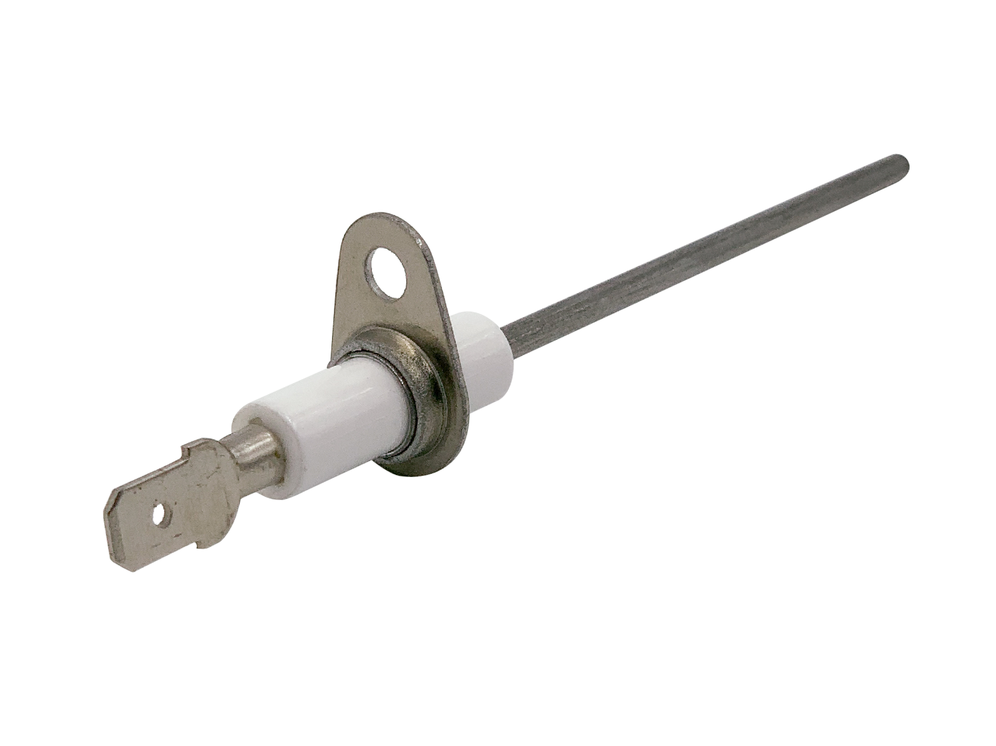
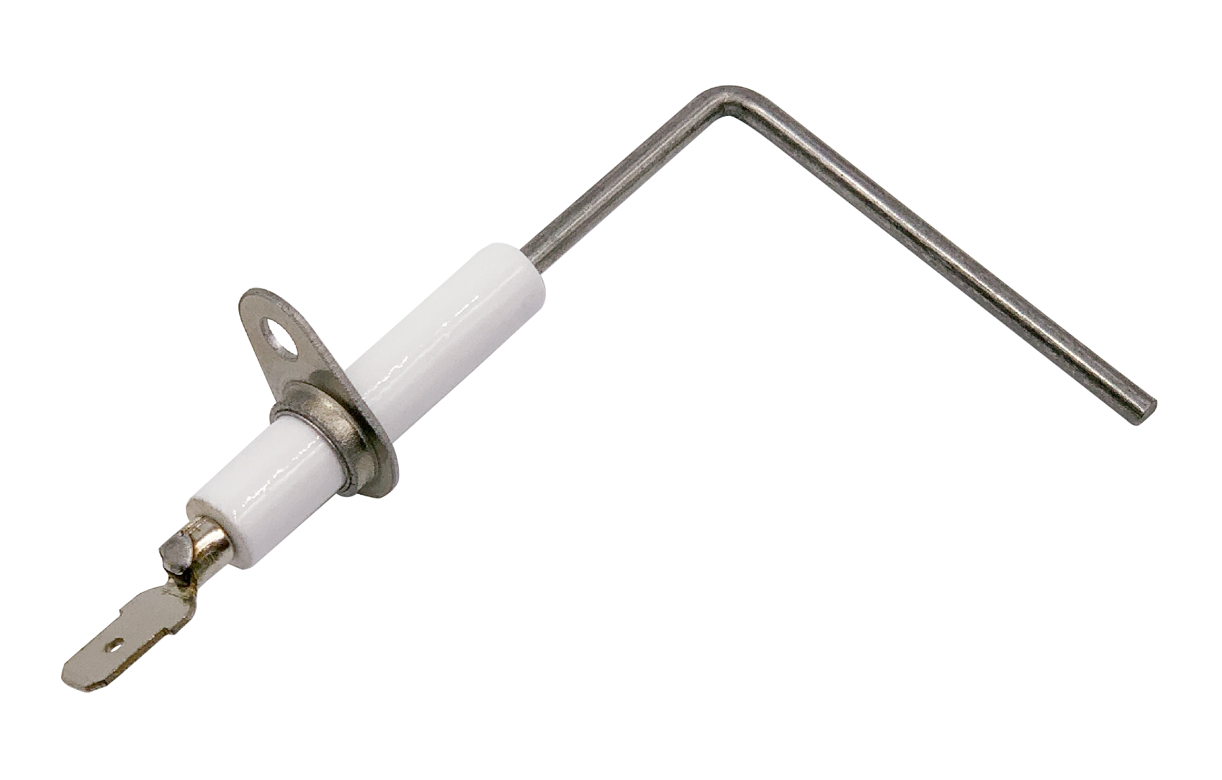
Flame Sensors
Direct Replacement Flame Sensors
Flame sensors connect to the ignition control and instantly detect flame for safe, controlled, reliable combustion
Direct replacement models offer drop in fit for major furnace brands
High temp rod material withstands 2200° F
Universal Flame Sensors
Universal styles can be bent or trimmed to shape to fit a wide range of applications
790-707A1
Flame Sensor
790-843A1
Universal Flame Sensor
790-801A1
Flame Sensor
790-956A1
Flame Sensor
790-820A1
Flame Sensor

Slide 18
Flame Sensors - Key Application Features
Replacement Type | Brands Replaced | Rod Angle | Connections | Model Number
Flame Sensors – OEM Direct Replacement and Universal
OEM Direct Replacement | Carrier | 73° Bend | 1/4” Male Spade Terminal | 790-751A1
 | Goodman | Straight Rod |  | 790-707A1
 | York |  |  | 790-801A1
 | Trane | 90° Bend |  | 790-820A1
 | Lennox |  |  | 790-956A1
Universal | All Brands | Straight Rod (Configurable to Match Existing Rod) |  | 790-843A1

Slide 19
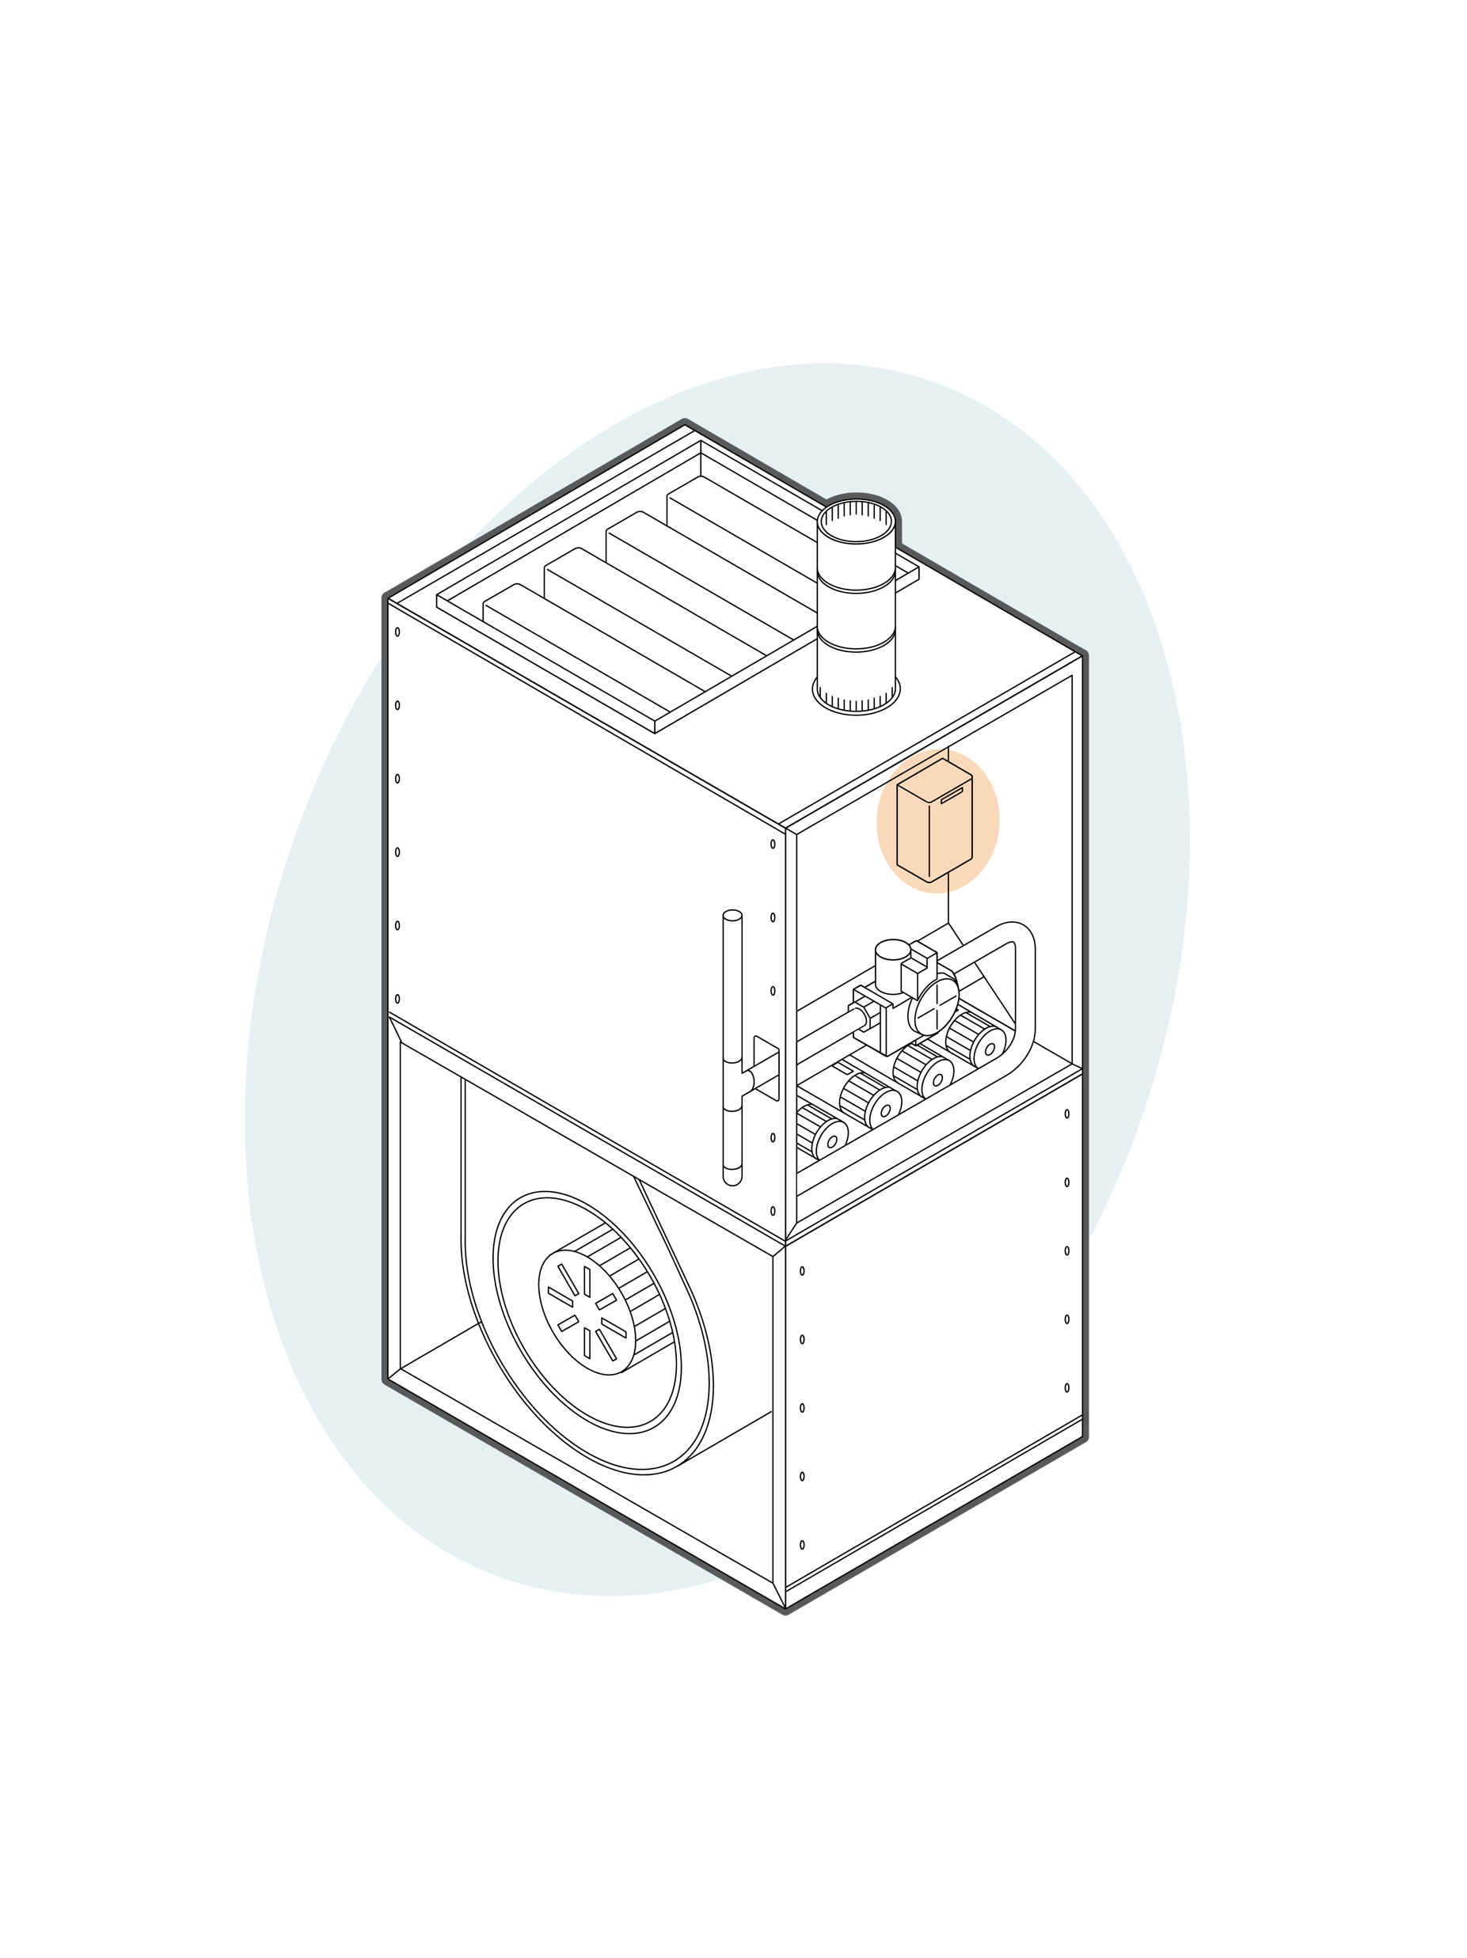
Fan and Limit Controls Overview
Fan and Limit Controls
Fan controls determine, based on time or temperature, when to turn the fan on and off
They provide a short delay turning the fan on so the air is warmed up before energizing the circulator
They also provide a short delay before turning the fan off after the combustion cycle to scavenge residual heat from the heat exchanger
Limit controls turn off the burners if the plenum temperature becomes too high for safe operation
Fan and limit controls are sometimes combined into one control with both functions, fan and limit

Slide 20
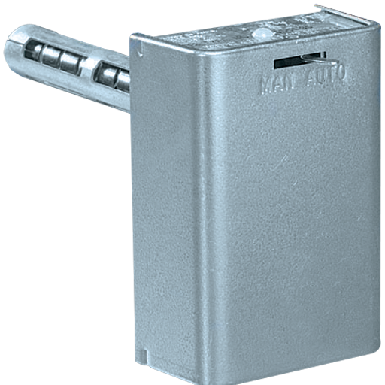
Fan and Limit Controls
Universal Furnace Electronic Fan Timer Control
Universal replacement for single stage PSC inducer and blower motor controls on non-integrated furnaces
Adjustable timings, LED status and fault indicator with fault recall button
Plenum Mount Bimetal Fan & Limit Controls
Bimetal fan and limit controls for legacy non-integrated and standing pilot furnaces
50F06-843
Furnace Electronic Fan Timer Control
5D51-90
Combination Fan and Limit Control
White-Rodgers Fan and Limit Controls replace
Over 1150 OEM and competitive models

Slide 21
Fan and Limit Controls Key Application Features
Brands Replaced | Stages | Product Type | Ignition Type | Inducer Motor/Blower Motor | Blower Motor Speed Taps | Connections | Model Number
Universal Electronic Fan Timer Control
All Brands | Single Stage | Electronic Fan Timer | HSI, DSI, Intelligent Gas Valve | PSC/PSC | Heat, Cool, Cont (Optional Low), ACC (Optional) | Thermostat Inputs R,C,W,Y,G | 50F06-843
Replacement Type | Switch Action | Length | Temperature Setpoint Range | Temperature Differential in Degrees | Amps. Inductive Full Load | Model Number | Model Number
Universal Plenum Mount Fan and Limits
Fan and Limit-Automatic Reset | Fan–Close on Rise, Limit-Open on Rise | 5” Element | Fan 50 to 265°F (10-129°C), Limit 100-300°F (38-149°C) | Fan Adjustable 15°F Minimum, Limit Fixed 25°F | Fan-14.0A, Limit-10.0A (120 Vac); Fan-7.0A, Limit-6.0A (240 Vac) | 5D51-35
 |  | 8” Element |  |  |  | 5D51-90
 |  | 11” Element |  |  |  | 5D51-78

Slide 22
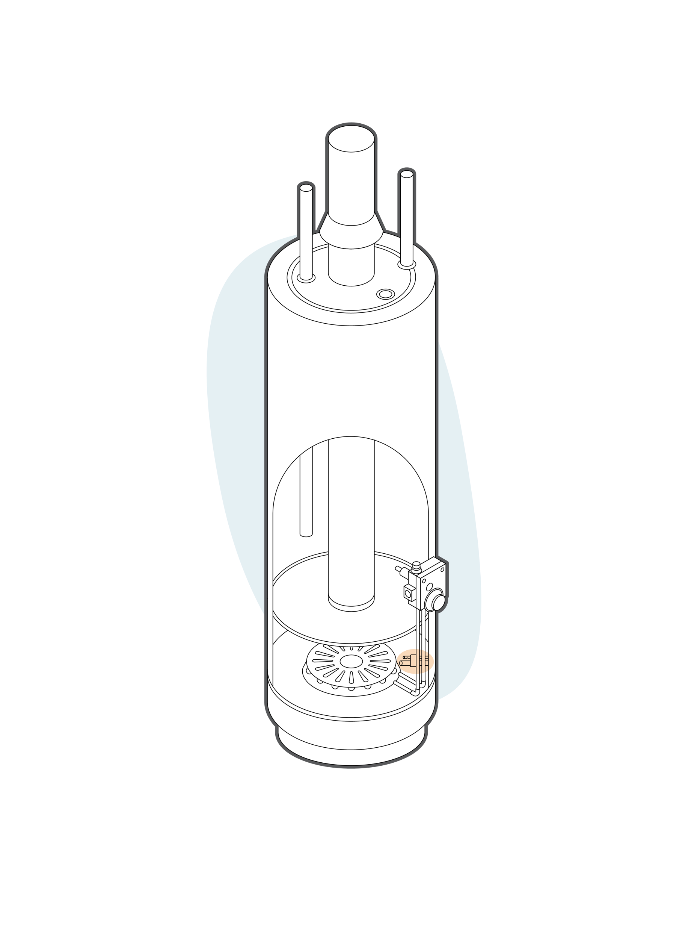
Standing Pilot Thermocouples and Generators Overview
Standing Pilot Thermocouples and Generators
Thermocouples in a pilot flame provide voltage to a gas valve pilot circuit, if the pilot goes out the gas valve closes
Generators in a pilot flame provide sufficient voltage to operate a gas valve and operate the gas valve pilot circuit in the same manner as a thermocouple

Slide 23
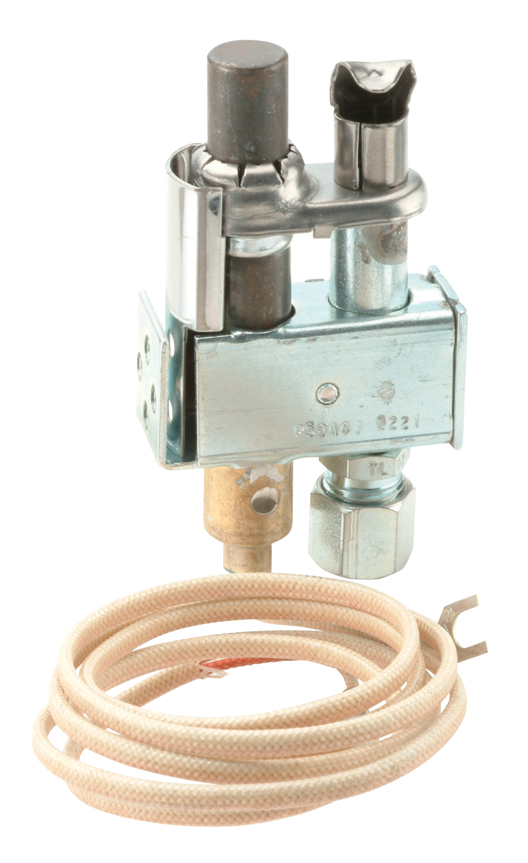
Standing Pilot Thermocouples and Generators
Standing Pilot Thermocouples
22-30 mV output with standard 11/32” double lead thread for powering gas valve pilot gas circuits
Universal adapter fitting included
Stainless steel element for long service life
Standing Pilot Thermopile Generators
750 mV output provides ample power for operating mV gas valves
Universal PG9 adapter fitting included
Bushing or spade connection terminal styles
Standing Pilot Thermopile Generators and Pilot Burners
Provides pilot flame and generates mV power to operate gas valves
Single blue flame for quiet operation with snorkel air path to eliminate linting
H06E-24
Thermocouple and Adapter
PG9A42JTL20
Generator and
Pilot Burner
G01A-332
Generator
White-Rodgers Standing Pilot Thermocouples and Generators replace over 170 OEM and competitive models.

Slide 24
Standing Pilot Thermocouples and Generators - Key Application Features
Voltage | Lead Length | Connections | Model Number
Standing Pilot Thermocouples
30 mV | 18” | Standard Thermocouple 11/32” Double Lead Thread | H06e-18
 | 24” |  | H06E-24
 | 36” |  | H06E-36
Thermopile Generators
750 mV | 32” Fiberglass Cable | R Bushing | 101934R32
 | 36” Armored Cable | F Spade Terminal | G01A-332
 |  |  | G01A-502
 | 36” Fiberglass Cable |  | G01A-512
Pilot Head Type | Orifice | Description | Model Number
Thermopile Generators and Pilot Burners
Cobra 90° Left | 0.02” | Includes Extra Base Fitting for LP Gas Application (Less Ferrule and Nut) | PG9A41JTL20
Cobra 90° Right |  |  | PG9A42JTL20

Slide 25
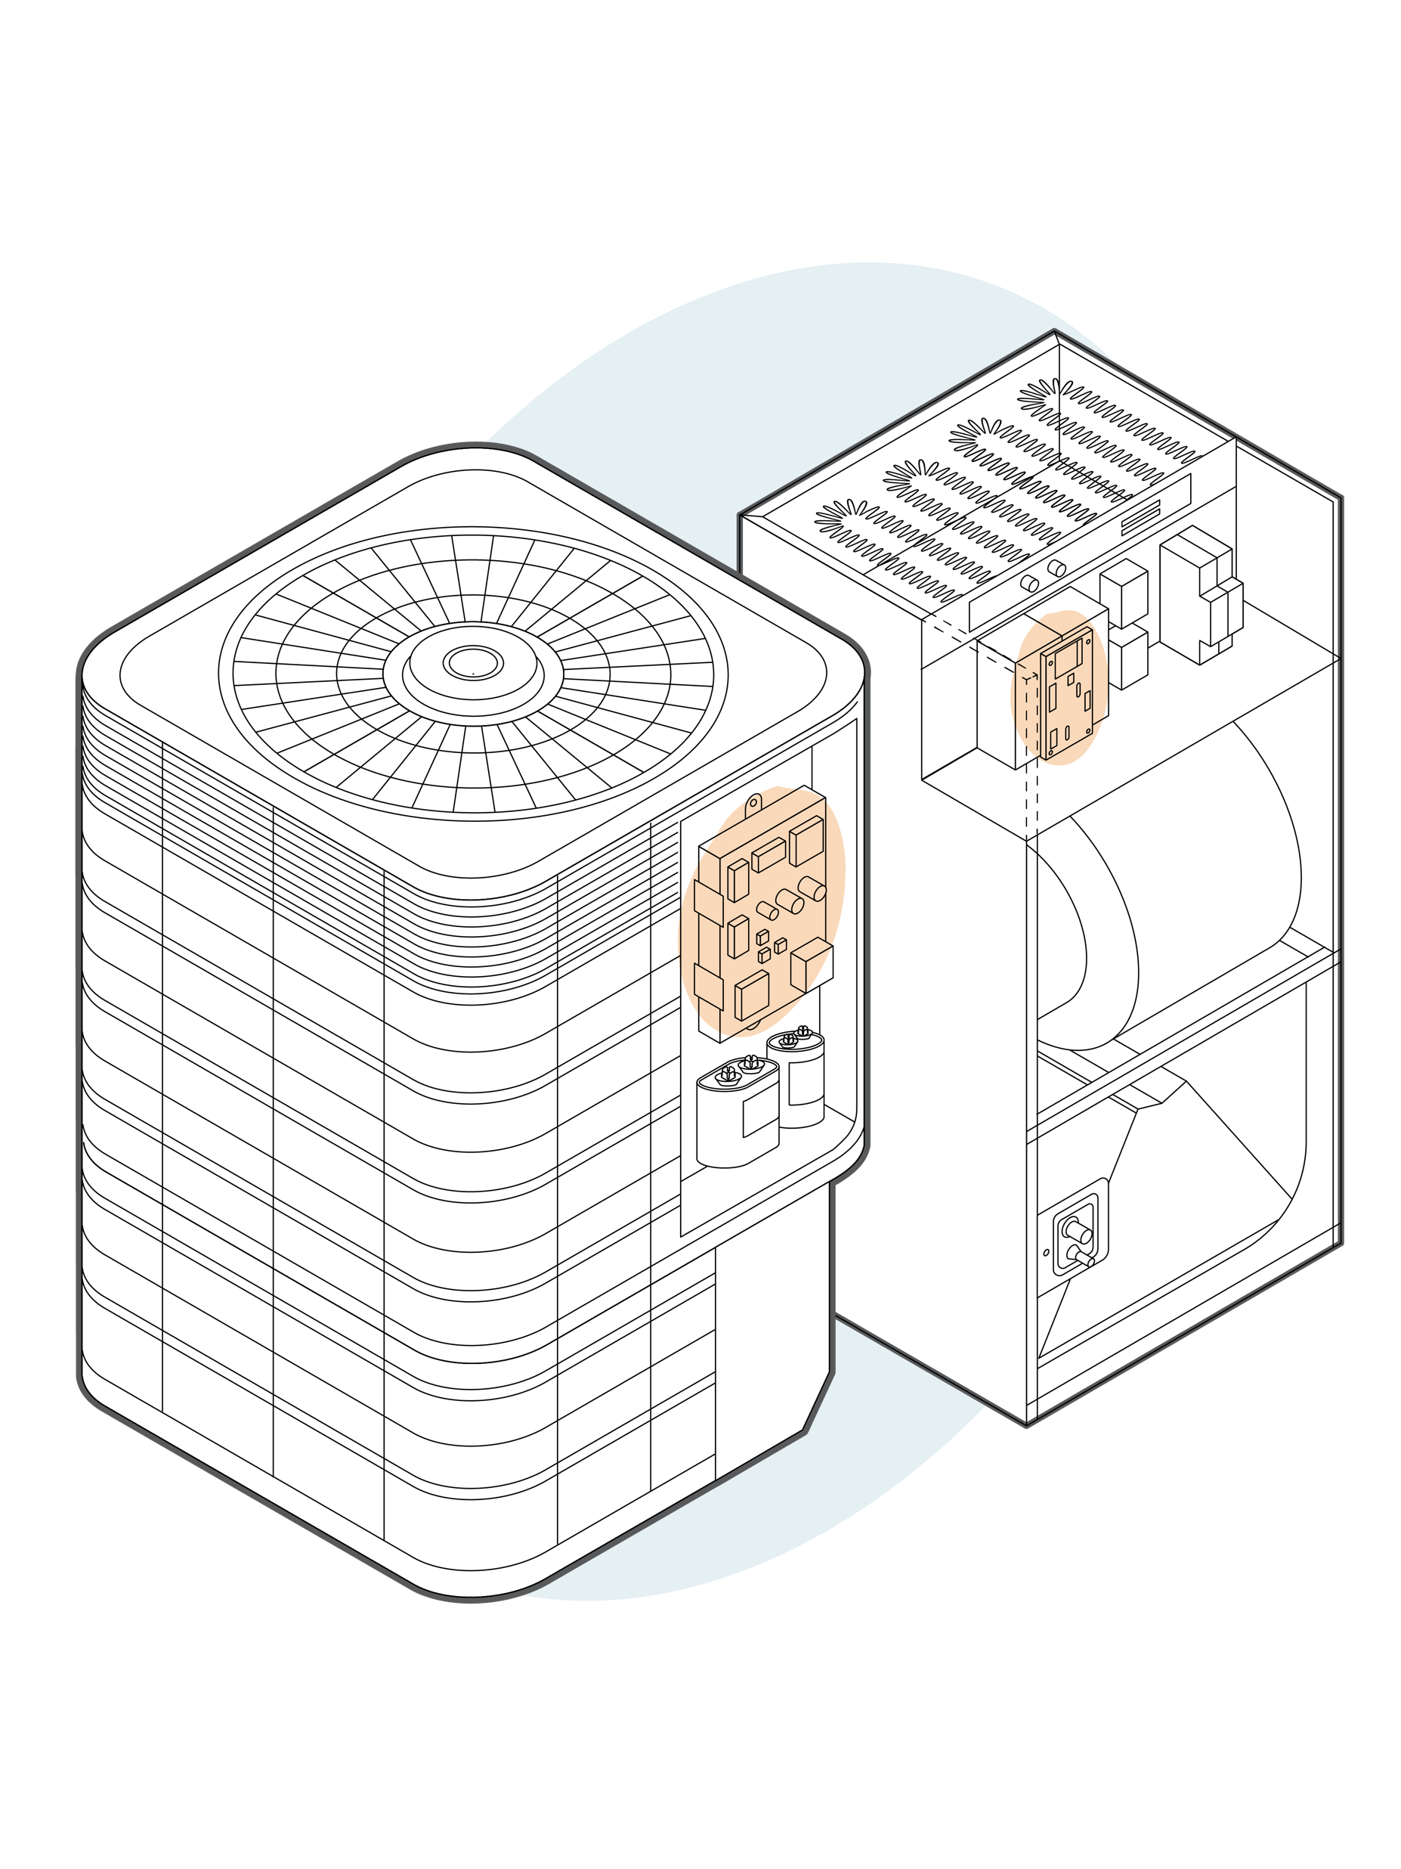
A/C, Heat Pump and Air Handler Controls Overview
AC, Heat Pump and Defrost Controls
AC and heat pump unitary controls are used to control outdoor fan motors
Defrost controls detect ice build-up on the outdoor coil and reverse refrigerant direction to melt ice build up off coil
Air Handler/Fan Coil Controls
Control PSC, ECMx and variable speed blowers in air handlers and fan coil units
Blower time delay relays allow residual cooled or heated air to circulate briefly after the call for cool or heat has expired to maximize energy savings and comfort

Slide 26
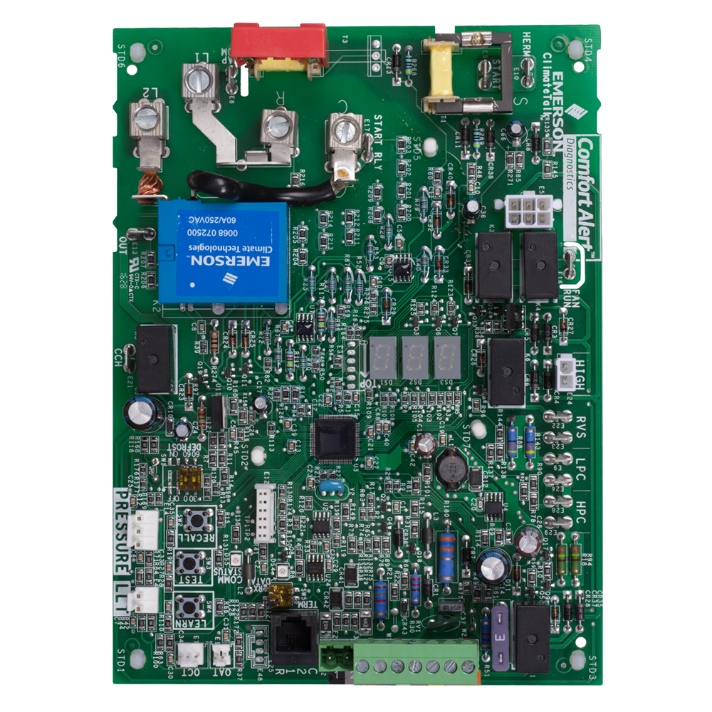
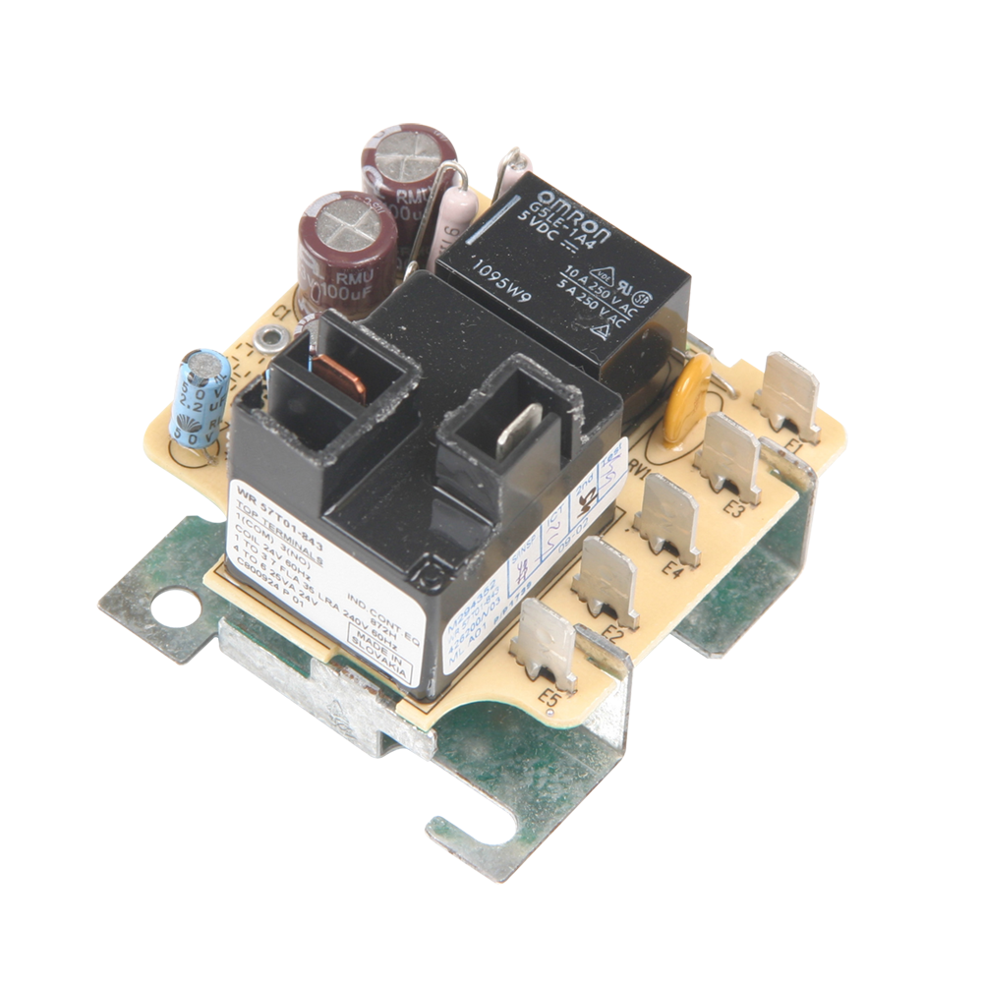
A/C, Heat Pump and Air Handler Controls
AC, Heat Pump and Defrost Controls
Two stage AC and heat pump unitary controls are used on PSC or ECM outdoor fan motors on single-phase compressors up to 5-tons
Microprocessor-based heat pump defrost controls to precisely control coil icing
Air Handler/Fan Coil Controls
Air handler and fan coil controls for PSC, ECMx and variable speed blowers
Blower time delay relays
49S25-707
A/C, Heat Pump Control
47D01U-843
Defrost Control
48P21-811
Air Handler/Fan
Coil Control
57T01-843
Air Handler/Fan Coil Blower Time Delay
White-Rodgers A/C, Heat Pump, and Air Handler Controls replace over 500 OEM and competitive models.

Slide 27
A/C, Heat Pump and Air Handler Controls - Key Application Features
Product Type | Replacement Type | Stages | Condenser Fan Motor | Connections | Model Number
A/C Heat Pump, Heat Pump Defrost Controls
A/C or Heat Pump Control | OEM Direct Replacement | Two-Stage | PSC or ECM | Thermostat Inputs 1,2,R,C,W1,Y1,Y2,O,L | 49S25-707
Defrost Control | Universal | Single Stage | PSC | Thermostat Inputs R,C/B,Y,O/B,W/D/X2,WIN | 47D01U-843
 | OEM Direct Replacement |  | PSC or ECM | Thermostat Inputs R,C,Y,B,D | 47D43-811
Product Type | Replacement Type | Stages | Inducer Motor/Blower Motor | Blower Motor Speed | Connections | Model Number
Air Handler Controls | OEM Direct Replacement | Single Stage |  | 1 |  | 48M55-751
Air Handler Control | OEM Direct Replacement | Single Stage | None/PSC or ECMx | 1 | Thermostat Inputs | 48M55-751
 |  |  | None/PSC |  |  | 48P55-751
 |  |  |  | M1, Fan |  | 48P21-811
Product Type | Replacement Type | Stages | Inducer Motor/Blower Motor | Model Number
Time Delay Controls
Time Delay Control | OEM Direct Replacement | Single Stage | None/PSC | 57T01-843

Slide 28
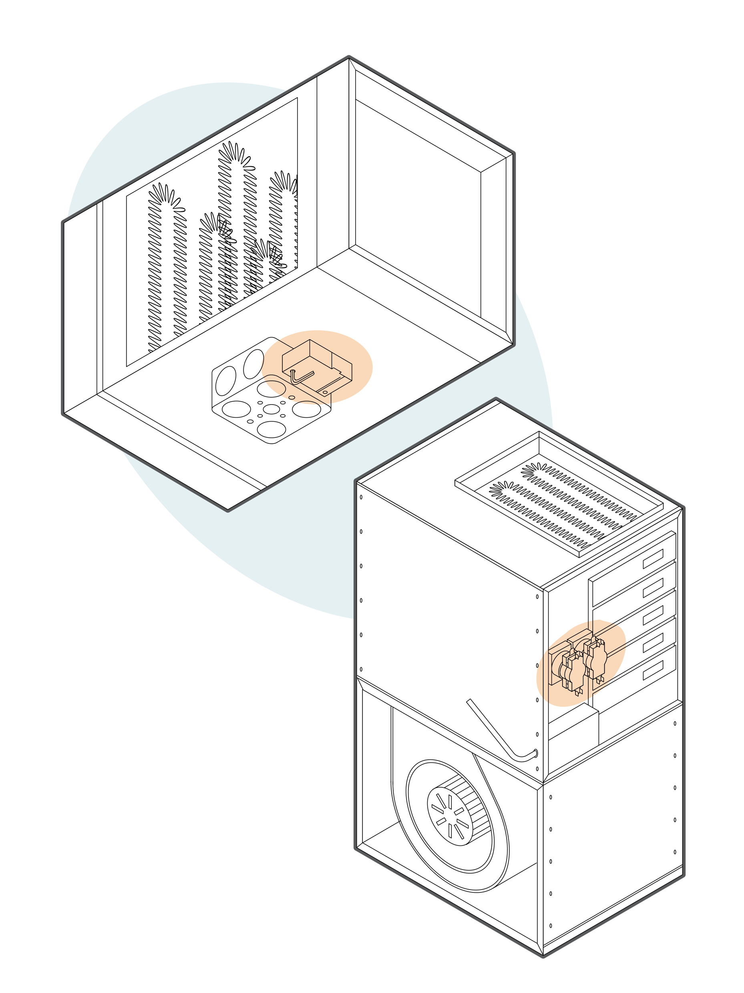
Electric Heat Sequencers and Level Temp Controls Overview
Electric Heat Sequencers
Heat sequencers control electric heating elements in electric heat furnaces and air handlers
Sequencing heating elements on or off at different times prevents tripping a breaker or dimming the lights in the building
Sequencers have a small low voltage onboard heater that warm the bimetal line voltage switches causing them to snap on - When power is removed, they cool down and snap back off
Level-Temp Controls
Level-Temp controls operate like heat sequencers but also include a low voltage transformer to connect a 2-wire low voltage thermostat and control line voltage electric heat loads
Commonly used for electric duct heaters, wall heaters, baseboard, floor and cable heating

Slide 29
Electric Heat Sequencers and Level Temp Controls
Electric Heat Sequencers
Heat sequencers are offered in a wide range of timings and number of switches to match the specific application
Standard 24 Volt input sequences up to five, line voltage loads with multiple timings to stagger the electrical load
Level-Temp Controls
Level-Temp controls provide a convenient way to add a 2-wire low voltage thermostat to an electric heater
24A34-6
Electric Heat Sequencers
White-Rodgers Electric Heat Sequencers and Level Temp Controls replace over 170 OEM and competitive models.
24A01G-3
Level Temp Control

Slide 30
Electric Heat Sequencers and Level Temp Controls - Key Application Features
Number of Timings/Switches | Switch Timings (Seconds) | Application Notes | Model Number
Electric Heat Sequencers
1/2 | Switch 1 and 2, On 30-90, Off 1-30 | M5-M6 and M7-M8 Switch On and Off Simultaneously. | 24A34-4
2/3 | Switch 1,2,3, On 1-10, Off 1-110 | M1-M2 and M3-M4 Switch On and Off Simultaneously and Are the First Switches to Turn On and Off. | 24A34-5
2/4 | Switch 1,2,3,4, On 1-110, Off 1-110 | M1-M2 and M3-M4 Switch On and Off Simultaneously and Are the First Switches to Turn On and Off. M5-M6 and M7-M8 Switch On and Off Simultaneously. | 24A34-6
Typical Applications | Operating Voltage | Frequency | Amps. Resistive | Amps. Inductive Full Load | Amps. Inductive Locked Rotor | Model Number
Electric Heat Level-Temp Controls
Electric Heat Level-Temp Control (Single) | 240 Vac | 60Hz | 25A (240 Vac) | 12A (240 Vac) | 72A (240 Vac) | 24A01G-3
 | 208 Vac |  | 22A (208 Vac) | 12A (280 Vac) | 72A (208 Vac) | 24A05E-1
Electric Heat Level-Temp Control (Dual) | 240 Vac |  | 25A (240 Vac) | 12A Per Switch (240 Vac) | 72A Per Switch (240 Vac) | 24A06G-1

Slide 31
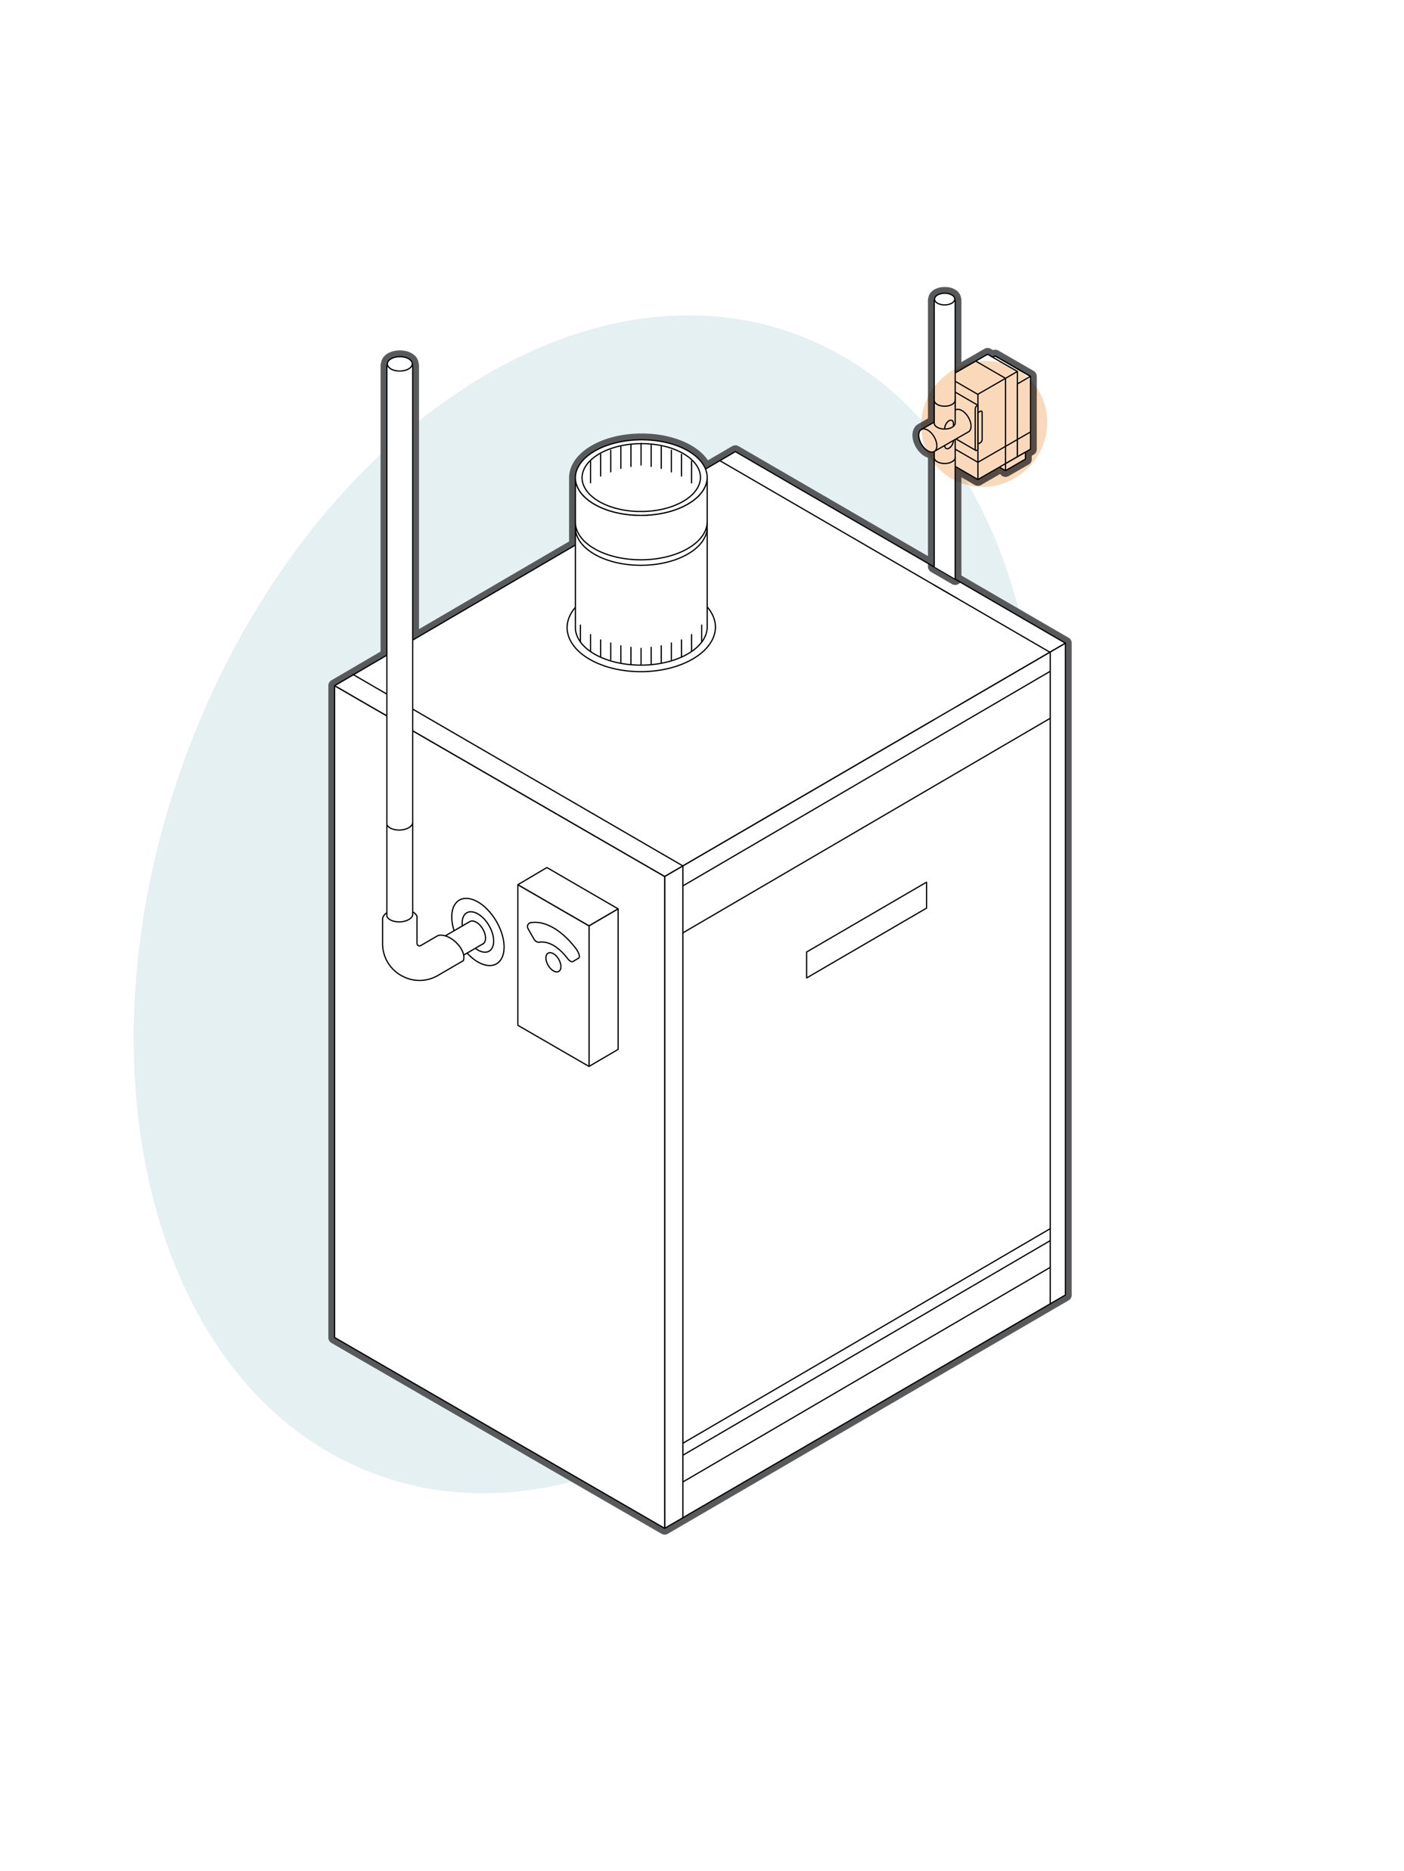
Hydronic Zone Valves and Temperature Controls
Hydronic (Hot Water) Zone Valves
Hydronic zone valves attach to the boiler piping controlling the flow of hot water (on or off) to one or more room radiators
Each zone valve connects to a room thermostat allowing individual temperature control in each zone or area within the building
Hydronic Temperature Controls
Well immersion hydronic temperature controls are inserted into a brass well in a boiler or hot water heat system and act as a thermostat to maintain proper operating temperature or as a high temperature limit safety device
Hydronic controls use a fast-acting hydraulic (fluid filled) element for sensing and controlling water tank temperature
Automatic Changeover Switches
Automatic changeover switches mount directly on the hot and chilled water piping and provide automatic heat/cool thermostat changeover when the water temperature switches between hot and chilled

Slide 32
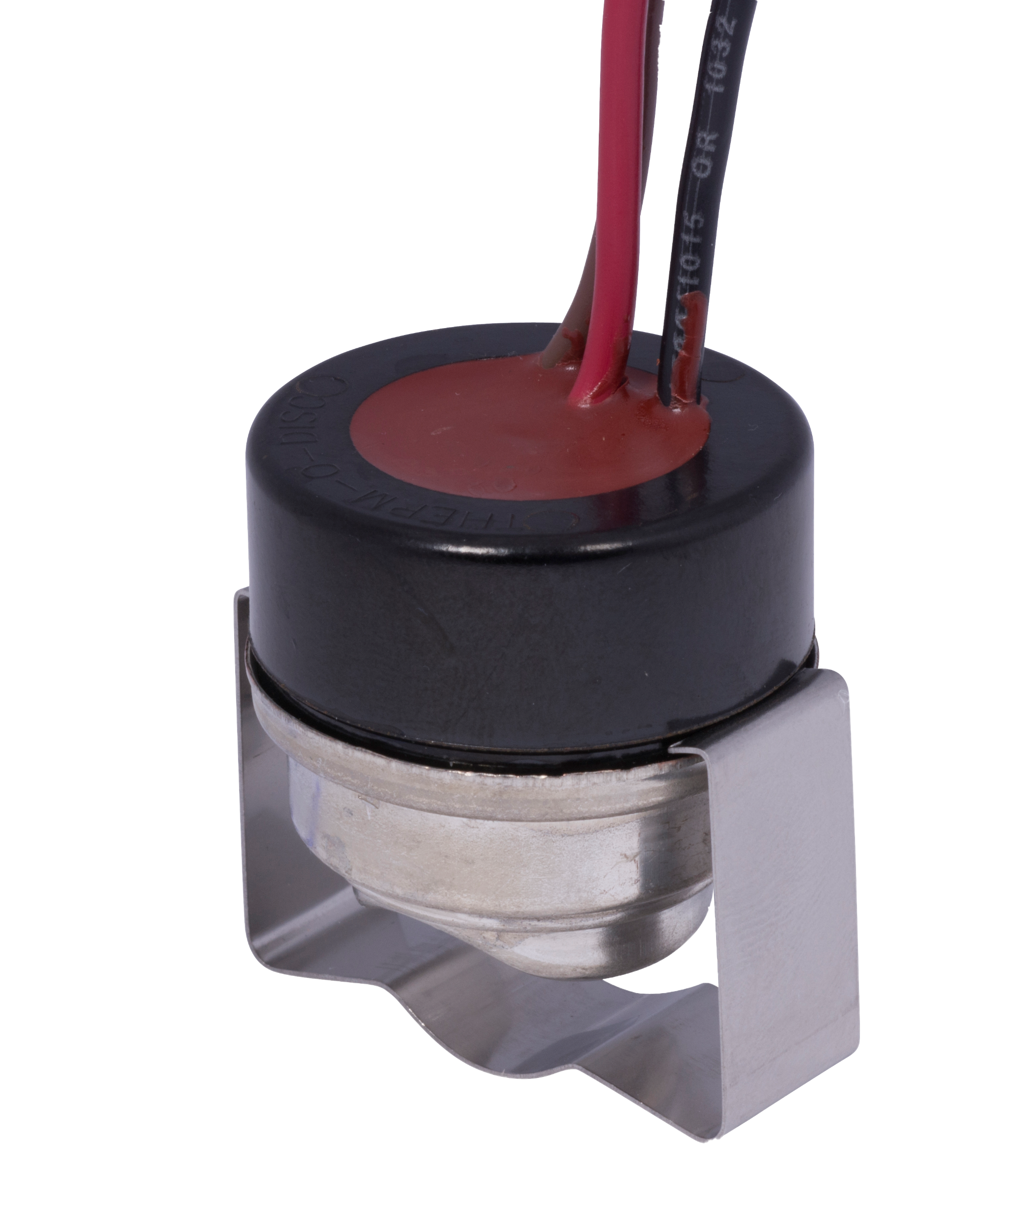
Hydronic Zone Valves and Temperature Controls
Hydronic (Hot Water) Zone Valves
Quiet and efficient zone control of boiler systems up to 50 PSI
Corrosion resistant brass and stainless steel
Hydronic Temperature Controls
Well immersion hot water temperature controls are used in boilers and for hot water heating requiring Open on Rise or SPDT switching
Use fast acting hydraulic element for sensing and controlling water temperature
Automatic Changeover Switches
Provide automatic Heat/Cool thermostat changeover on combination hot and chilled water systems
1361-102
Hydronic Zone Valve
11D18-1
Hydronic Temperature Control
752-1
Automatic Changeover Switches
White-Rodgers Hydronic controls replace
Over 620 OEM and competitive models.

Slide 33
Hydronic Zone Valves and Temperature Controls - Key Application Features
Inlet x Outlet Size | Voltage | Auxiliary Switch | Maximum Operating Pressure | Maximum Pressure Differential | Maximum Media Temperature | Flow (Cv) | Model Number
Hydronic Zone Valves
3/4” ODF | 24 Vac | Yes | 50 PSI | 15 PSI | 240°F | 23.5 GPM @ 1 PSI Drop | 1311-102
 |  |  |  |  |  |  | 1361-102
Temperature Setpoint Range | Temperature Differential | Bulb Size | Switch Action | Amps. Inductive Full Load | Model Number
Hydronic Temperature Contsol
100 - 240°F | 7-45°F | 2-7/16” x 7/16” Tapered, with 1/2” Std. Shank Well | SPDT | 7.4 (120 Vac), 3.7A, (240 Vac) | 1131-102
 | 5-45°F | 3-9/16” x 3/8” No Wells Included | Open on Rise | 10.0A (120 Vac), 6.0A (240 Vac) | 11D18-1
 | Fixed 10°F | None (Surface Strap On) | SPDT | 7.4 (120 Vac), 3.7A, (240 Vac) | 1127-2
Temperature Setting | Lead Length | Amps. Inductive Full Load | Amps. Inductive Locked Rotor | Amps. Resistive | Pilot Duty | Model Number
Automatic Changeover Switches
Red-Black Open at 85° Plus/Minus 6°; Red-Brown Open at 70° Plus/Minus 6° | 12” With Stripped Ends | 7.5 (120 Vac), 3.75A (240 Vac) | 45.0A (120 Vac) 22.5A (240 Vac) | 15A (120, 240, 277 Vac) | 15A (120, 240, 277 Vac) | 752-1

Slide 34
Water Heater Controls Overview
Gas Water Heater Controls
Standard atmospheric types control temperature and gas flow on most residential gas water heaters currently in service
Newer power vented types control temperature, gas flow, ignition and the combustion blower on the latest generation of more efficient water heaters (Intelli-vent power vented water heaters)
Commercial water heater types control temperature and electrical high temperature cut out
Electric Water Heater Controls
Electric water heater thermostat and limit control the electric heating elements are used together to combine adjustable temperature settings with fixed high temperature limits

Slide 35
Water Heater Controls
Gas Water Heater Controls
37C standard atmospheric models are the most common gas water heat controls in service
37E power vented controls are the latest generation water heater controls featuring more energy efficient combustion
11B79 controls are used on larger commercial units for temperature and safety control
Electric Water Heater Controls
750 series are the most common electric water heater controls in service controlling both temperature and high temperature limit
37C73U-168
Gas Water Heater Controls
37E73A-906
Intelli-Vent Water Heater Controls
11B79-3
Commercial Water Heater Control
756-50
Electric Water Heater Thermostat and Limit Control
White-Rodgers Water Heater Controls replace
over 149 OEM and competitive models.

Slide 36
Water Heater Controls - Key Application Features
Brands Replaced | Regulator Setting | Temperature Setpoint Range | Length | Model Number
37C Gas Water Heater Controls
A. O. Smith, Robertshaw | Main 3.5” W.C. (Nat. Gas), Pilot 4.0” W.C. (Nat. Gas) | 70-160°F (21-71°C) | 1-1/4” Shank | 37C73U-168
OEM Manufacturer | Replaces Models: | Model Number
37E Gas Water Heater Controls Intelli-Vent
State Industries | 9005964005, 37E73A-306 | 37E73A-906
Thermostat Electrical Rating | Thermostat Switch | E.C.O. Electrical Rating | E.C.O. Switch Action | Model Number
Commercial Gas Water Heater Controls
24 Vac – .075 Amp 0.25 – 1.0 VDC – 0.25 Amp 10 F.L.A., 60 L.R.A., 120 Vac | Open on Rise Differential: Fixed 4°F | 24 Vac – .075 Amp 0.25 – 1.0 VDC – 0.25 Amp | Open on Rise @ 205°F (96°C) Differential: Non-Cycling Manual Rese | 11B79-3
Switch Action | Temperature Setpoint Range | Amps. Resistive | Model Number
Electric Water Heater Controls
Open on Rise (Thermostat) | 90 - 150°F | 30.0 (120/240 Vac), 25.0A (277 Vac), 12.5A (480 Vac) | 755-1
Open on Rise (Manual Reset Limit and Thermostat) | Limit Fixed at 170, Thermostat 90 - 150°F |  | 756-50

Slide 37
Relays and Transformers Overview
Relays
Relays combine a coil designed for a specific input voltage and one or more sets of contacts that open or close when the coil is energized to drive other system devices
Energizing the coil through a thermostat or other switch creates a magnetic field forcing the contacts to move open or move closed
Most relays selected for HVAC applications use a low voltage (24V) coil with contacts selected to match the low or line voltage load required to drive fan motors, humidifier circuits or other auxiliary equipment
Transformers
Transformers combine primary and secondary coils in close proximity. When power is applied to the primary leads it creates a magnetic field inducing a voltage on the secondary coil side
Transformers in HVAC applications step the primary line voltage input down to inherently safe low voltage (24V) to power relay coils that switch the line voltage power

Slide 38
Relays and Transformers
General Purpose Switching/Fan Relays
Light to medium duty relays
Heavy duty relays
Plug-in fan center/general purpose relays
24 Volt Class 2 Energy Limiting Transformers
Foot, Hub, Plate and Multi-mount mounting styles
Single or multiple primary voltages
90-293Q
Light to Medium Duty Relays
90-340
Fan Control Center or General Purpose Relays
S84A-410
Transformer
White-Rodgers Relays and Transformers replace over 1100 OEM and competitive models.
90-380
Heavy Duty Relays
90-T40F3
Transformer

Slide 39
Relays and Transformers - Key Application Features
Product Type | Coil Voltage | Switch Type | Contact Rating Full Load Inductive | Contact Rating Locked rotor Inductive | Contact Rating Resistive | Model Number
Relays
General Purpose Relay | 24 Vac | SPDT | 830A (125 Vac) | 25.0A (125 Vac) | 8.0A (250 Vac) | 90-293Q
General Purpose Relay-Heavy Duty |  | SPNO/SPNC | 12.0A (125 Vac), 8.0A (250 Vac) | 60.0A (125 Vac), 48.0A (250 Vac) | 18.0A (277 Vac) | 90-380
Fan Center-General Purpose |  | DPDT | 12.0A (125 Vac), 6.0A (240/277 Vac) | 60.0A (125 Vac), 35.0A (240/277 Vac) | 15.0A (277 Vac) | 90-340
Voltage | Frequency | Connections | Secondary VA | Model Number
Transformer
Primary Input 120 Vac, Secondary Output 24 Vac | 50/60 Hz | Primary-Leads, Secondary-Leads | 40 | 90-T40F1
Primary Input 120/280/240 Vac, Secondary Output 24 Vac |  |  |  | 90-T40F3
Primary Input 120 Vac, Secondary Output 24 Vac | 60 Hz | Primary-Leads, Secondary Terminals |  | S84A-410

Slide 40
WR Mobile App
Always up-to-date and easy to use:
Mobile App
White-Rodgers Website
Your resource for:
Product information and spec sheets
Complete Cross Reference
OEM compatibility
Installation information and videos
Wiring diagrams
Download:
Go to your app store
Type in WR Mobile
Install the app
OR
Open your camera
Hold it over the QR code
Tap “Open” on the
pop-down
Install the app

Slide 41
WR Mobile App
Easy to use!
Search by OEM, Competitive, or White-Rodgers Model Number
Product Number
Scrollable Product List
WR Replacement

Slide 42
White-Rodgers Cross Reference
Go to: www.whiterodgers.com
Hover over Tools & Resources
Click on: White-Rodgers Cross Reference/Product Information
Enter the Model Number or click on: Search Replacement Heating Controls by Major OEM Brand

Slide 43
Wholesale Resource Site
Access useful resources to grow your business.
Visit: https://climate.emerson.com/en-us/brands/white-rodgers/white-rodgers-wholesaler-resource-center
You’ll find videos, stocking lists and product launch information for the following product families:
Heating Controls
Cooling Controls
Sensi Smart™ Thermostats
Traditional Thermostats
Contractor Rewards
Product Merchandising

Slide 44
Why Contractors Trust White-Rodgers
Industry Leading Products
Used by more OEM’s
Offering the widest range of Universal Replacement Controls
Ease of Installation
Simple, easy to understand instructions
Product Reliability
Quality Control assures reliable products
Affordable
Competitive pricing
Supported by Knowledgeable Representatives
Contractor direct phone support
R-5251

